Slide 1
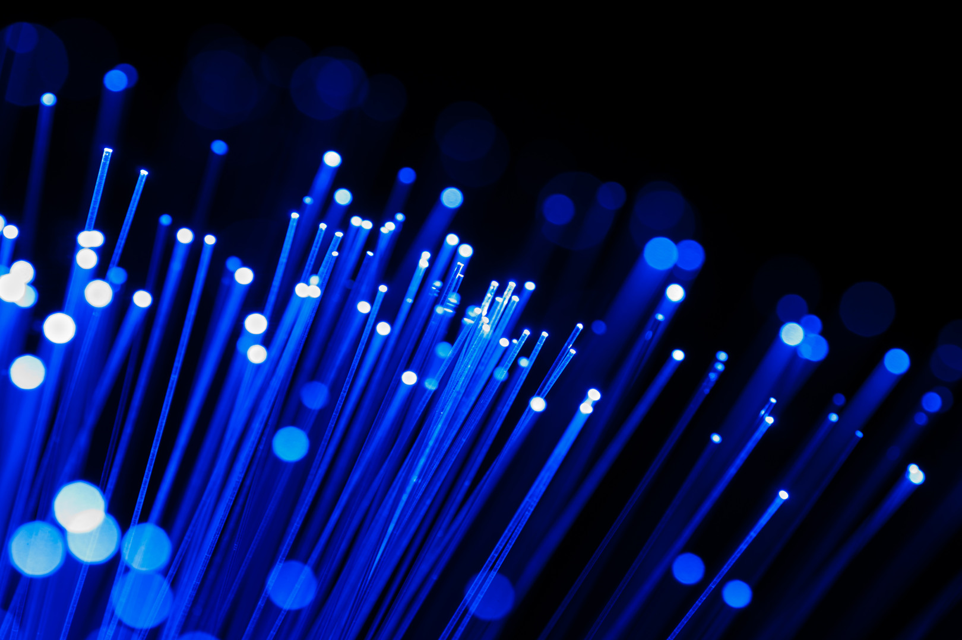



Monitoring Video, Audio & Anc data in a hybrid SDI – IP world
What You Need to Know for Day-to-Day Operation
Steve Holmes
Application Engineer

Slide 2
IP is Just Another I/O Interface
Just remember that IP is just another I/O interface: A way to get video, audio, and data to or from a switch. _{(JB)}
  It’s how you do that that has changed.

Slide 3
Broadcaster Migrate path to IP
Although many broadcasters are transitioning to IP, the majority are going to do so in a piecemeal manner.
With ST-2110, the timing information has been removed from the underlaying hardware layer making the distribution asynchronous.
With current broadcast formats, video must be frame synchronous at the camera’s sensor and at the viewers television screen.
The intermediate IP distribution network is asynchronous but the variance in packet jitter directly affects latency leading to potentially longer video and audio delays than we have come to expect from SDI infrastructures.
Although uncompressed video such as that provided by ST-2110 does map to the active video parts of SDI, two major changes have occurred;
  The PTP and SPG may or may not be the same device
  Signal distribution in IP is asynchronous and multiplexed.
Notes:
Furthermore, the PTP distribution
relies on phase locked loops to provide synchronization and correctly specified PTP-aware Ethernet switches. Now we have an asynchronous PTP system that has its own variable jitter influenced by Ethernet switches, transmission lines, and terminal equipment, as well as a synchronous SDI system.

Slide 4
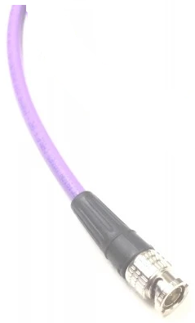

SDI Transmission
In SDI we send Video, Audio and Data all on the same Coax line by line
We send a Field or Frame of Video, the Audio that goes with Field or Frame and the Anc data that goes with that Field or Frame.
HANC
A
U
D
I
O
VANC Data

Slide 5
IP Transmission
In IP we send Video, Audio, and Data on 3 different IP Multicasts
These different multicasts can be on the same fiber but do not have to be
VANC Data
-40 Data
HANC Audio
-30 Data
-20 Data

Slide 6

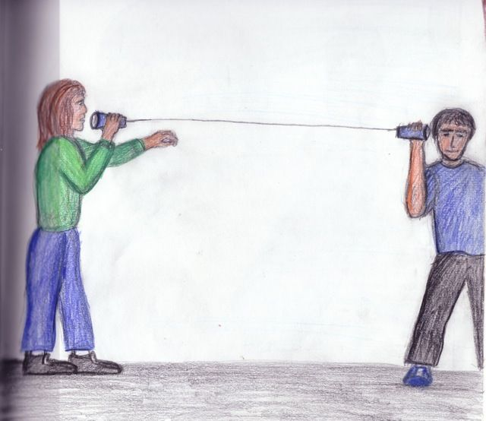






Unicast, Multicast, Broadcast
May I Join
In an IPv4 network, the hosts can communicate one of three ways:
Unicast
  Sending a packet from one Host to another Host
Broadcast
  Sending a packet from one host to all host in the network
Multicast
  Sending a packet from one host to a selected group of hosts
May I Join
May I Join
(Switch)

Slide 7
SMPTE ST 2110
There are several parts to ST 2110
ST 2110 uses separate video, audio, and metadata as essence payloads, or Flows
Uses essence over RTP/UDP
Uses PTP for synchronization (IEEE1588 with SMPTE ST 2059-2 Profile)
These three IP flows make up your program
ST 2110-20 Video
ST 2110-30 Audio
ST 2110-40 Data
Source IP Address
Dest IP Address
RTP Header
Video Payload
(RFC 4175)
Source IP Address
Dest IP Address
RTP Header
Audio Payload
(AES 67)
Source IP Address
Dest IP Address
RTP Header
Metadata Payload
(IETF)

Slide 8
Analog Video to SDI
Things we had to do
In Analog Video we could hang an O-Scope on the video coax and look at it
We had to come up with a way to look at SDI , take 10 bits make a Pixel out of it put that Pixel on the screen
In Analog Audio we could put an O-Scope on the audio and see the Audio.
We had to come up with a way to grab the channel that we wanted from the data out of the HANC and make an audio waveform out of it.

Slide 9
SDI to IP
We have to do a lot of the same things
SDI allowed us to carry the Audio and Captions (and several other things) in the Video payload. New tool sets and new ways were created to look at them.
Well we have done it again.. we have moved everything around, And put it on IP, not just IP but 3 different IP Multicasts,
We needed to find / make new tools to look at Video/ Audio / Data(Captions). And make sure the Video/ Audio / Captions etc. are compatible with being put back to SDI if needed.
We will look at how to do this and see IP and SDI side by side.

Slide 10
Engineering verses Day to Day Work
IP Trouble shooting;
You need a deep tool set to trouble shoot the IP layer
  IP flow status, Packet Jitter, PTP, PTP timing, Buffer, 2022-7 and more
But that’s not what you need for day to day operations
Day to Day work;
  Waveform, Vector, Captions, SCTE104, Audio, Loudness, compare IP to SDI feed.

Slide 11
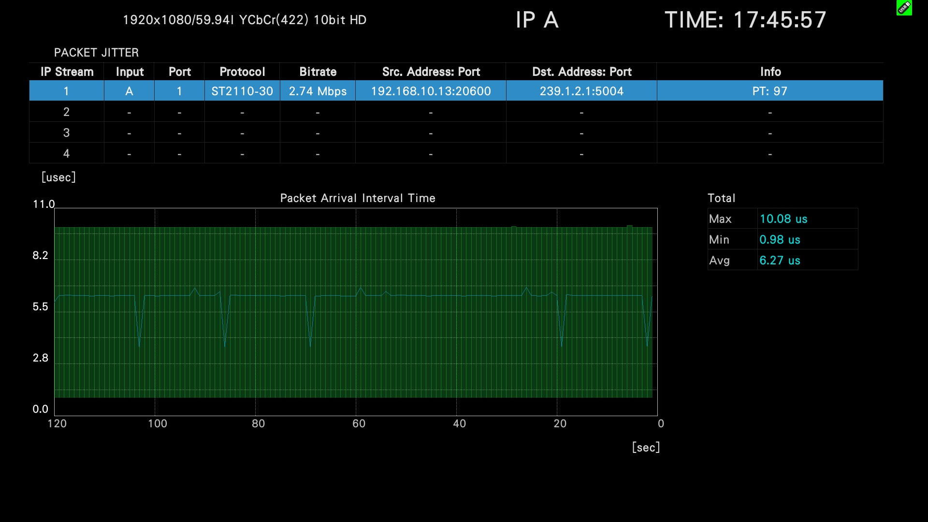
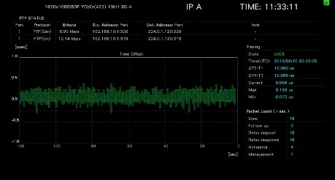
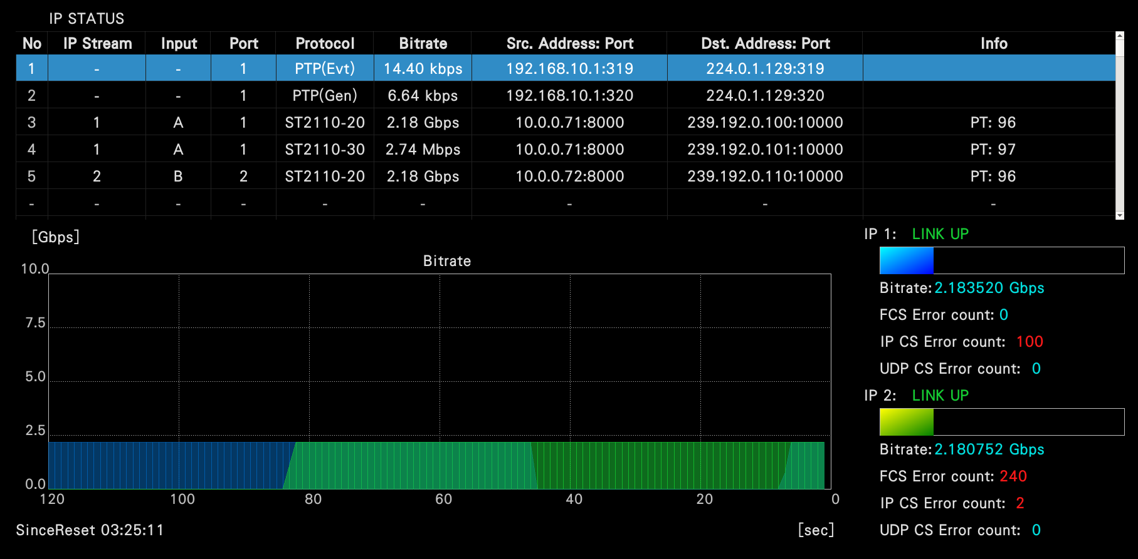
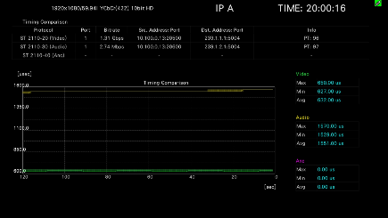

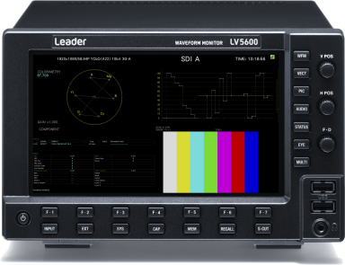
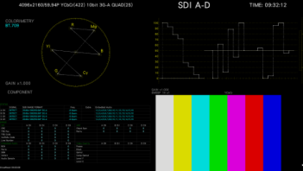
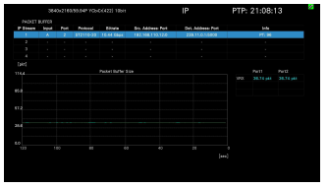
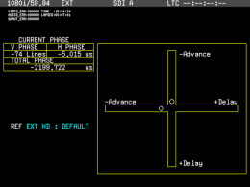
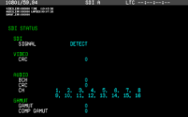
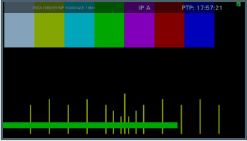
LV5600 and LV7600 IP Features
IP Status
Packet Jitter
PTP
Engineering Tool Set
PTP Timing
IP Pattern Generator
2022-7 Timing
Buffer
Phase Adjustment
Status
IP Lip Sync

Slide 12
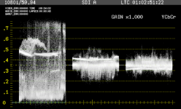
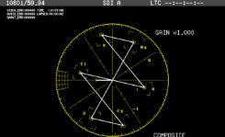

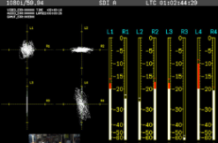
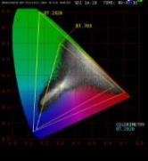
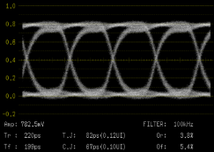
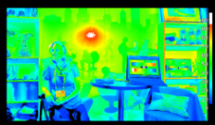
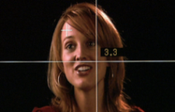
LV5600 and LV7600 SDI Features
Waveform
Vector
Picture
Day to Day Tool Set
Audio - Loudness
4K Pattern Generator
CIE
EYE Pattern *
CineZone
Phase Adjustment
Status
CineLite

Slide 13
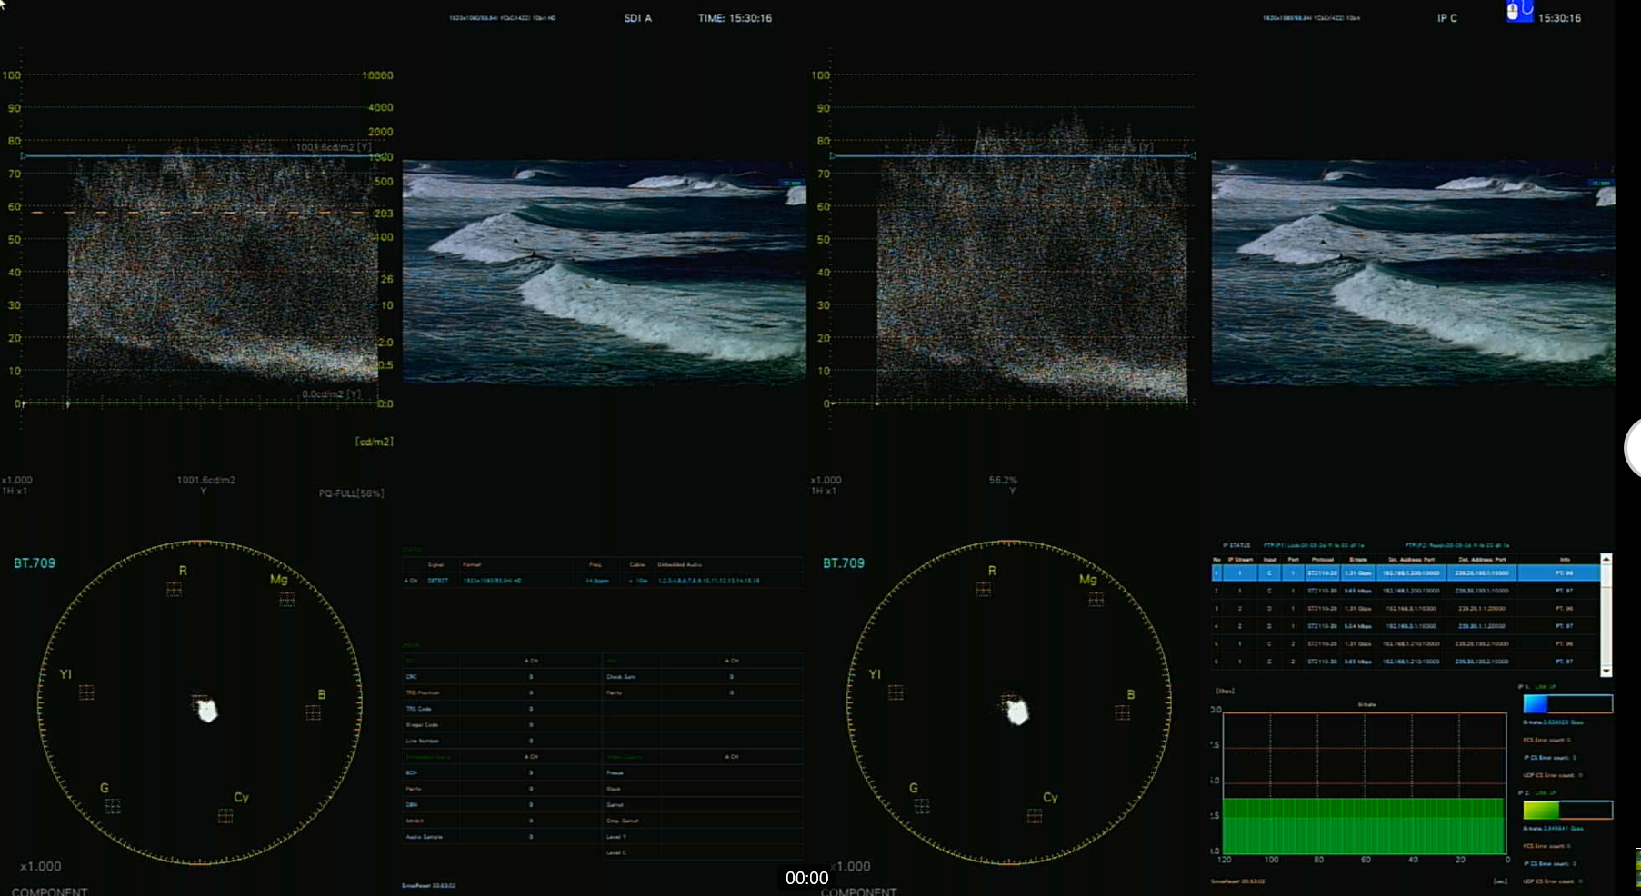
True Hybrid Operation.
How to look at both SDI and Ip streams at the same time.
SDI A
IP C
SDI Status
IP Status

Slide 14
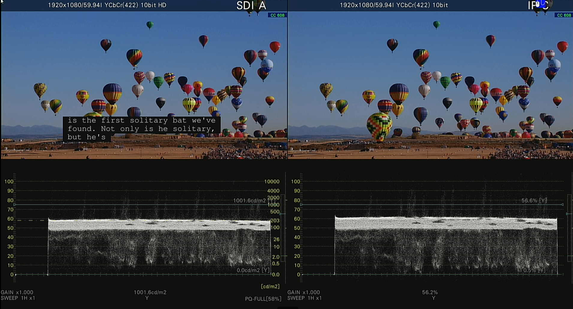
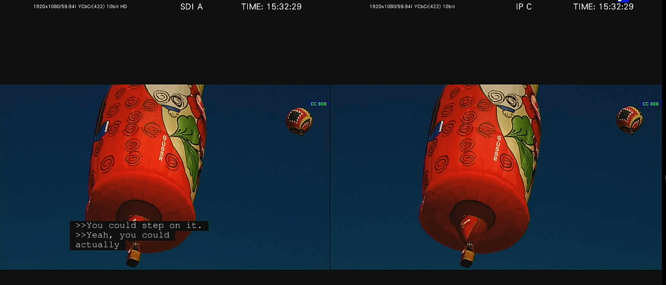
True Hybrid Operation.
How to look at both SDI and Ip streams at the same time.
SDI A
IP C
608 Captions
608 Captions

Slide 15
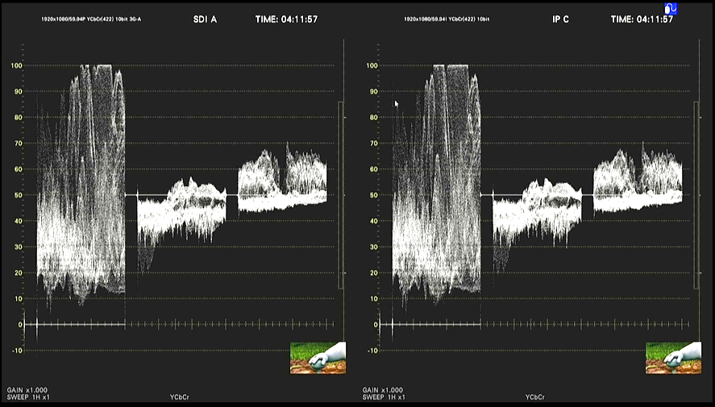
Look at waveforms in the same way
But have tools that will go deeper if needed

Slide 16
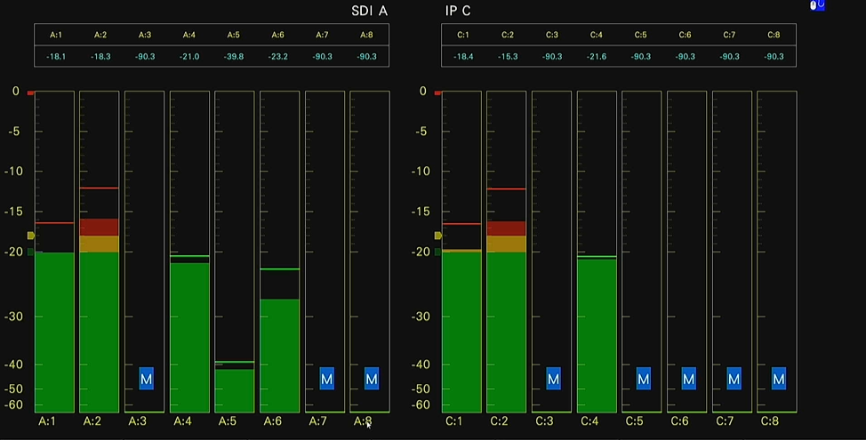
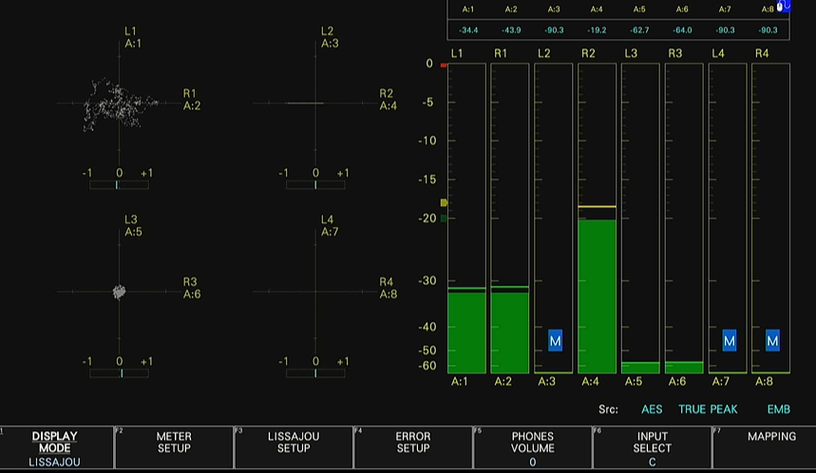
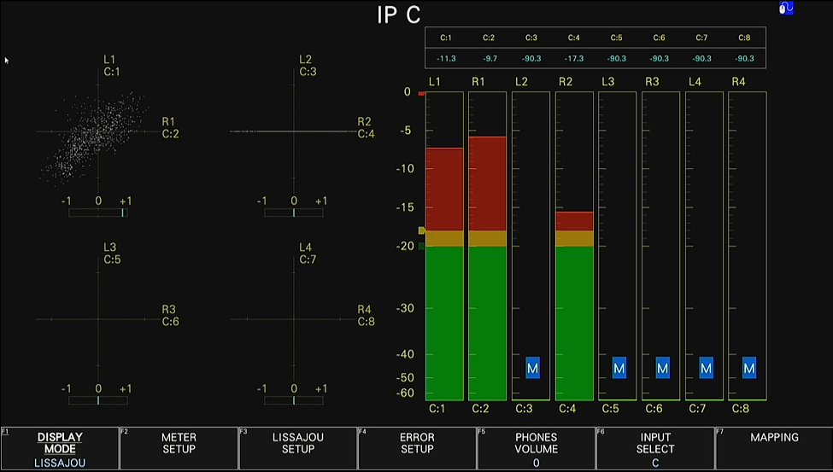
Look at audio in the same way
Look at the audio in the same way we are use to
Surround Channels missing
SDI
Input A
Lissajou
SDI
Input A
Bars
IP
Input C
Lissajou
IP
Input C
Bars
SDI
Input A
Bars

Slide 17
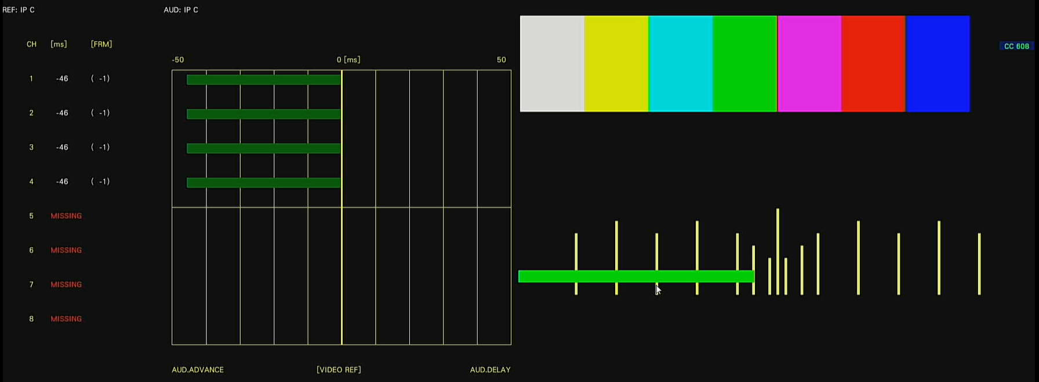
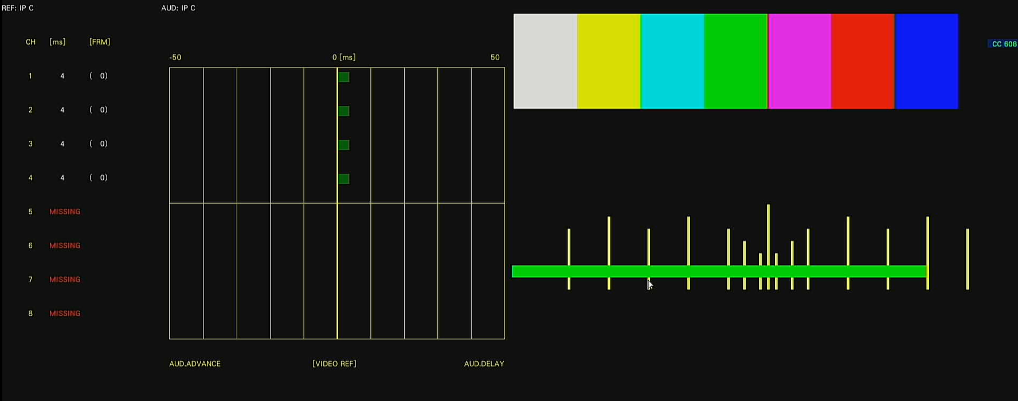
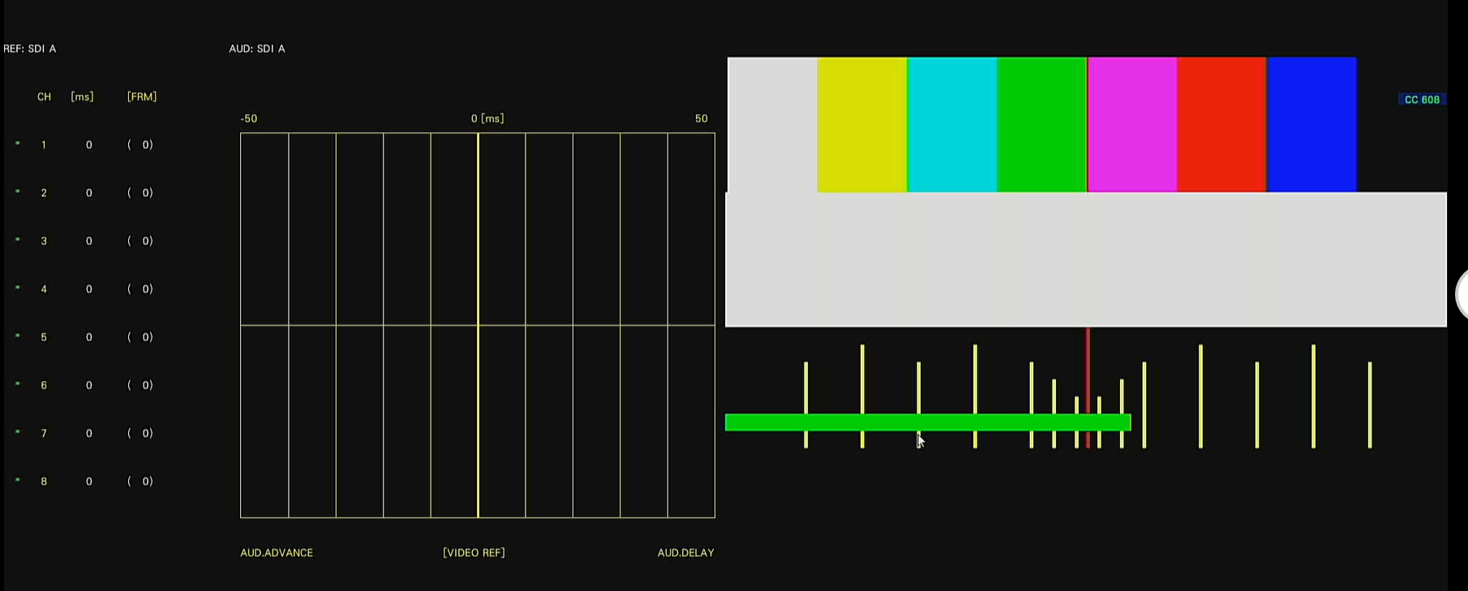
Audio / Video Delay
Check Audio to Video delay from SDI through IP
SDI A input 0 offset +/-
IP C input -46ms
IP input 4 ms Delay after compensating

Slide 18
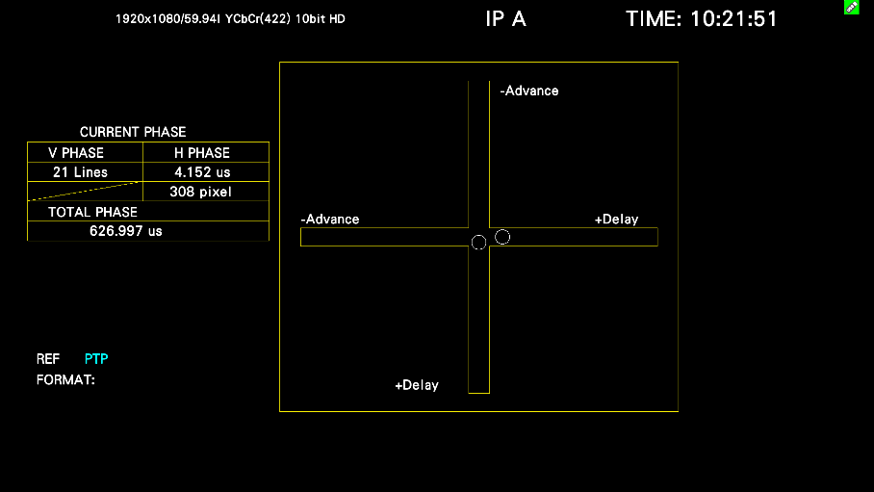
PTP / RTP Timing (Leader)
V Phase Delay of 21 lines is the delay between EAV and SAV (1080i) (1080p 42 lines)
LV5600 / LV7600
PTP Zero Point same as Black
Video RTP Start Point
EAV
SAV
VANC
HANC
Active Pixels
Mbit
PTP to RTP
Notes:
EAV – End of Active Video
SAV – Start of Active Video
Mbit – Marker Bit

Slide 19
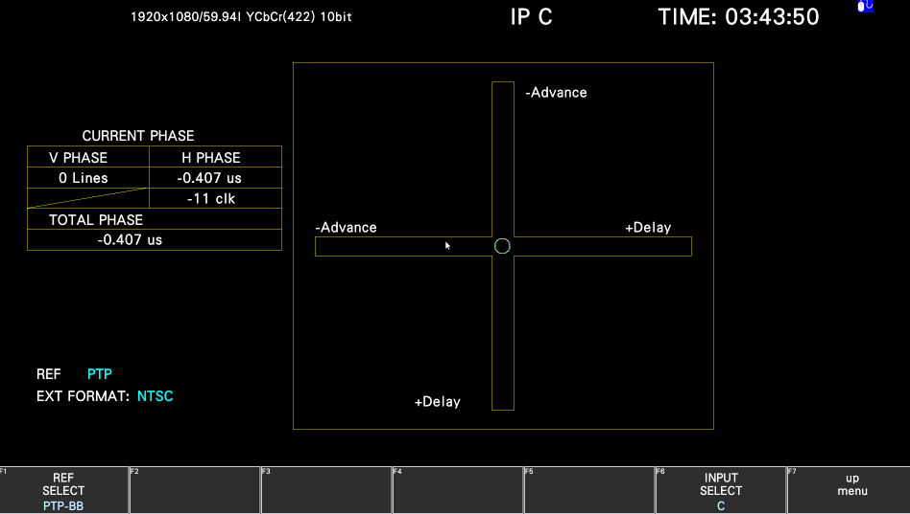
PTP to BB Timing (Leader)
PTP to analog BB or Tri reference
Start of Black Burst and Normal Start of PTP
VANC
HANC
Active Pixels
Reference

Slide 20
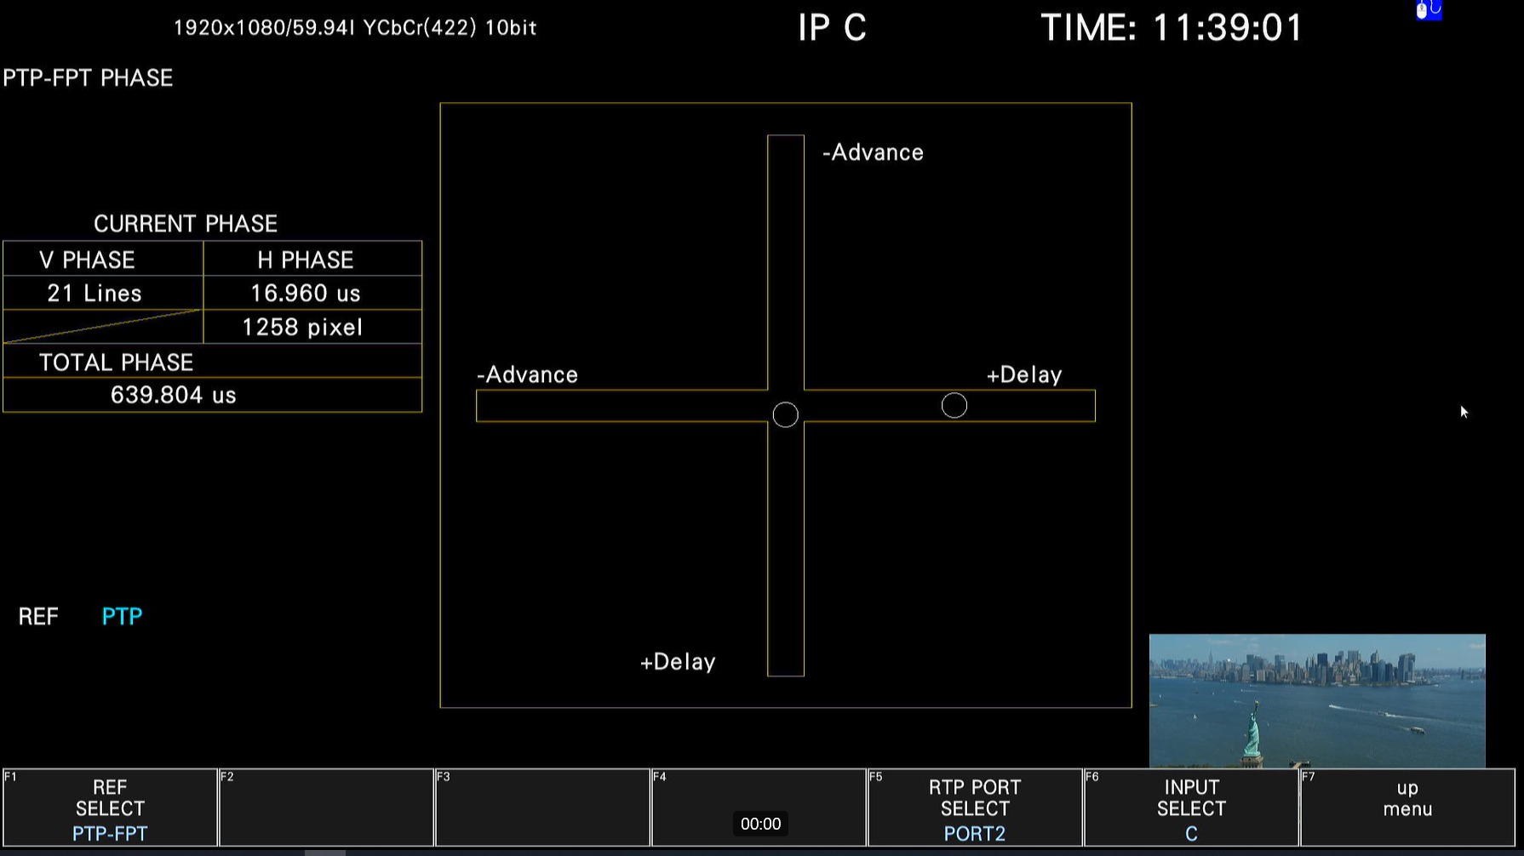
PTP to FTP Timing (Leader)
PTP to First packet Time
Reference
PTP to FPT

Slide 21
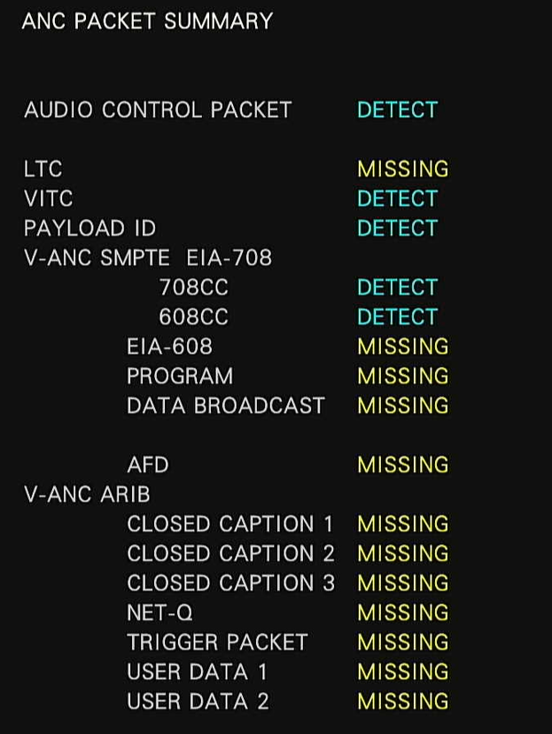
ANC Data View

Slide 22
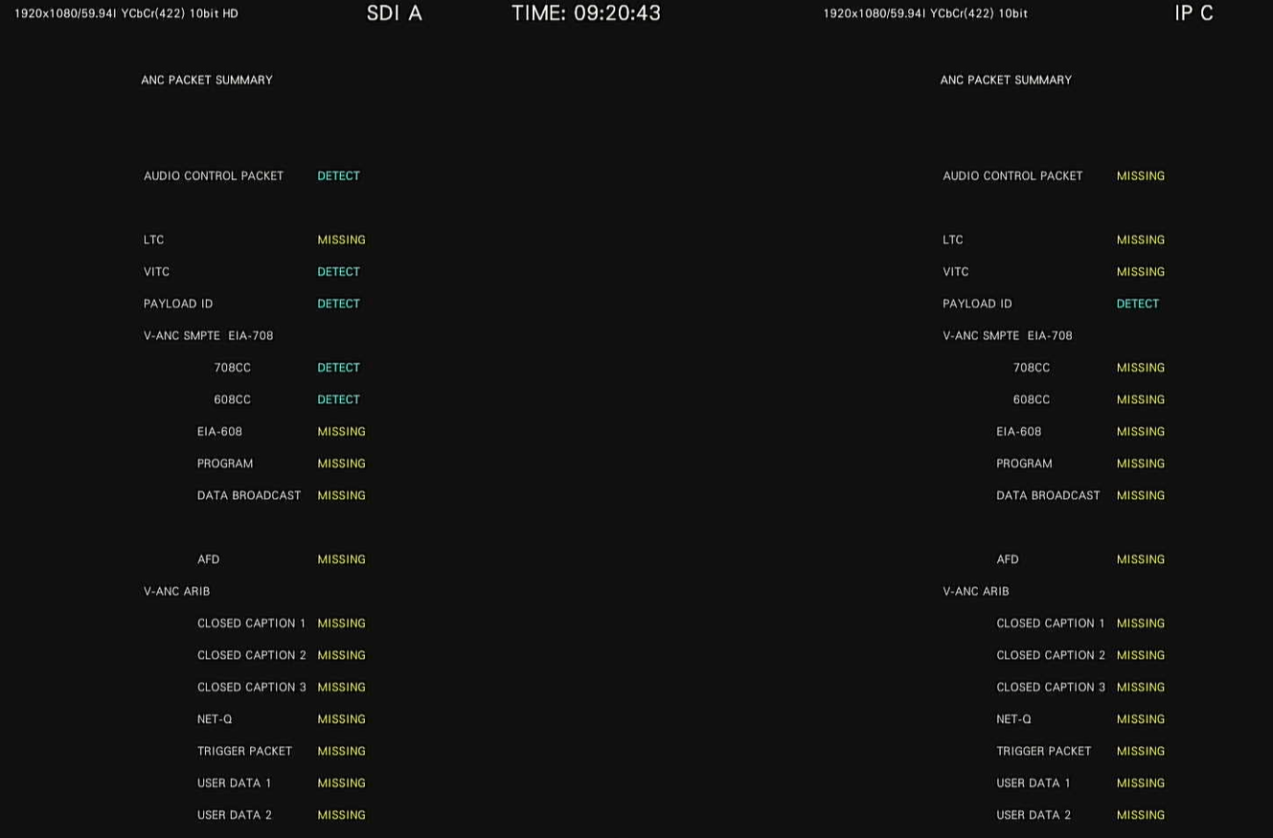
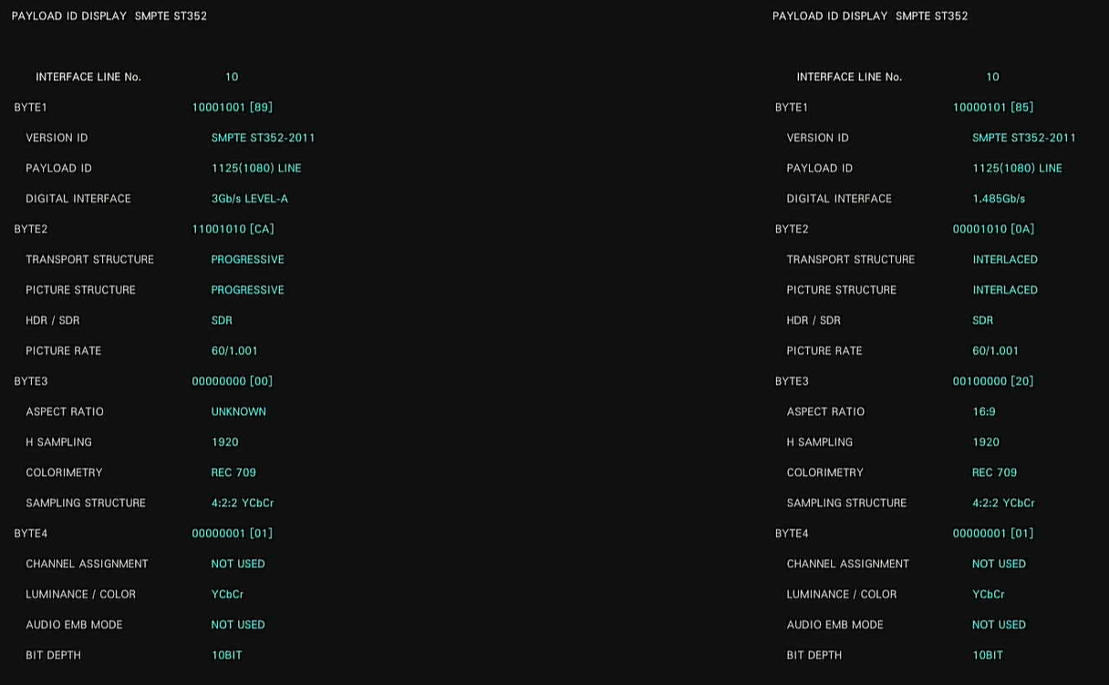
Side by Side ANC Data

Slide 23
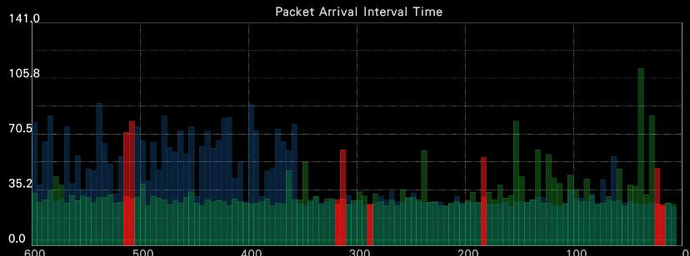
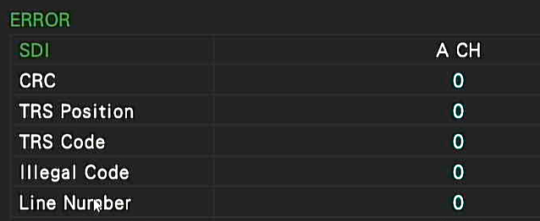
SDI verses IP Physical layer
Transmission errors – Dropped Data
SDI we look at CRC errors
In IP we look at RTP errors
  CRC errors will not pass through a IP switch.

Slide 24
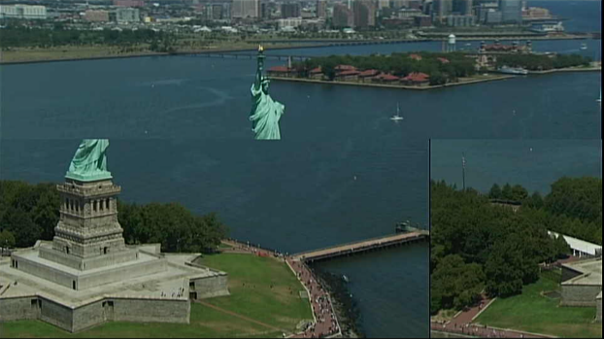
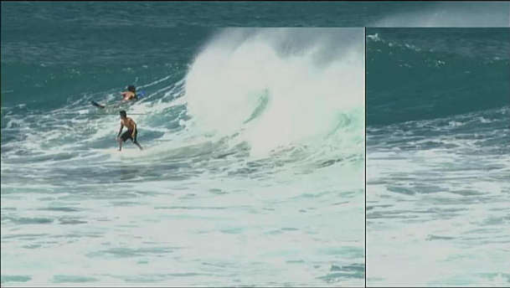

View of Errors
Every device may show the errors in a picture a little different, it is all in how they build the picture.
In 1080i one IP packet is about ¼ if a line, that’s how much data will be lost for one packet error.
Some are going break up randomly
Some will have lines of bad pixels jumping all over the place
Some will go to black on the error

Slide 25

Picture Breakup Slice

Slide 26

Picture Breakup Pixel Lines

Slide 27
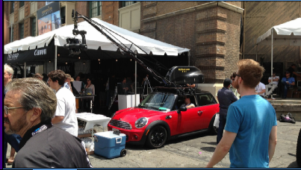
Picture Breakup Blackout

Slide 28

Packet Errors
Packet Errors
No Packet Errors
Errored
Data
No Packet Errors
Good data
Data Loss but No Packet Errors
No Packet Errors
Errored IP frames (Packets) are dropped and not propagated
We need to look at this in a different way
One dropped Packet is about ¼ of a 1080 line.

Slide 29
RTP Errors
Packet Errors
No RTP Errors
RTP Errors
Errored
Data
No RTP Errors
RTP Errors
Good data
No RTP Errors
Data Loss and RTP Sequence Errors
We can detect errors using the RTP Sequence

Slide 30
Recap
Remember IP is just another IO interface – its how we look at it.
You need tools that will still show you errors that you can relate back to SDI.
You need to be able to see Inputs side by side.
You need timing tools to verify that your SDI and IP are locked to the same clock.
Simple user configurable Multi View screen.

Slide 31

Thank You
Questions?

Slide 32
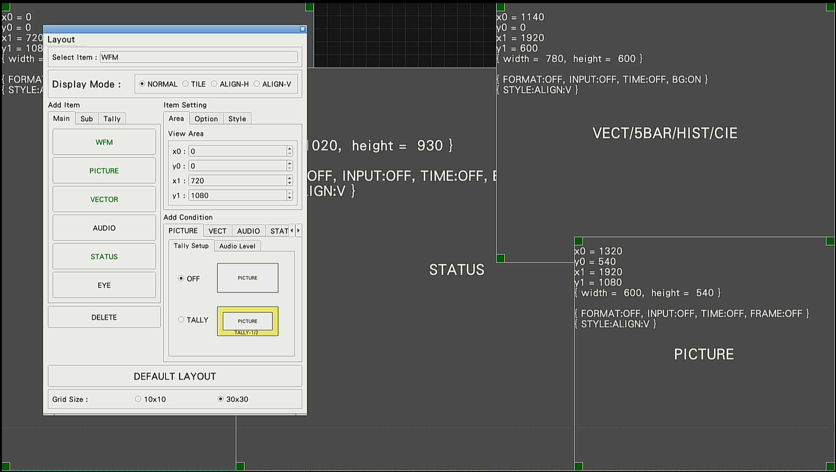
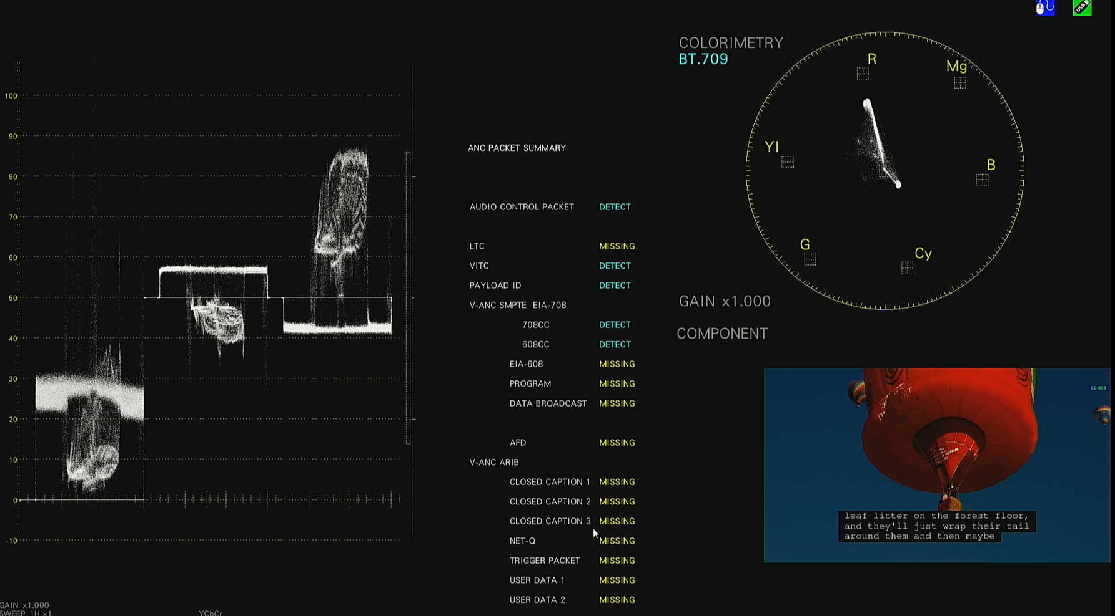
Custom Page Layout
WABE2

Slide 33
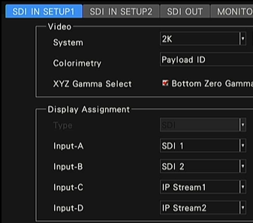
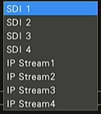
Completely Mappable Inputs
Map any input to IP or SDI input
There are 4 Display engines. 1, 2, 3 or 4 inputs can be on the screen at the same time
Map any input to SDI or IP

