Slide 1
How Will AI Change the Media Industry?
Roy Folkman – CineSys.io
(Human Presenter)

Slide 2
Agenda
Introductions
Presentation
Panelists Comments
Your Comments and Questions

Slide 3
Panelists:
Gerry Belec
Director – News Technology and Operations
Corus Entertainment/Global News
Chris Lapp
Technical Solutions Architect – Media and Entertainment
Cisco

Slide 4
Out of Respect for the Spirit of WABE, This Presentation is Not Commercial in Any
Way. Solutions
and Companies
are Shown in the Context of the Presentation.
We Have No Commercial Relationship with
Any Companies Shown.

Slide 5
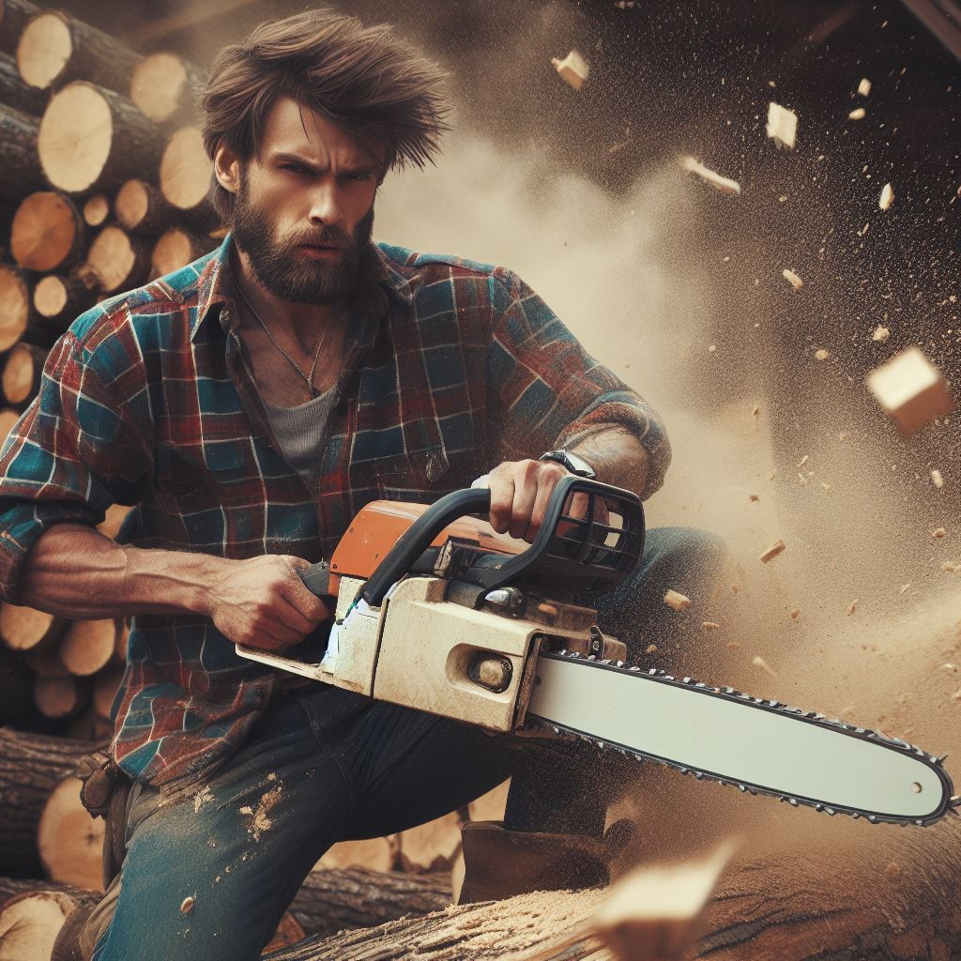
Warning: In this presentation, someone who grew up in a small BC logging town is going to talk about their feelings and talk about things philosophical.

Slide 6
AI is going to bring on the greatest change in the history of the media industry. This presentation will outline that perspective. It is OK if you disagree. In fact, it is encouraged. The only way we are going to be able to navigate the overwhelming changes brought on by AI is through thoughtful and respectful exchange of ideas.

Slide 7
The upshot is simply a question of time, but that the time will come when the machines will hold the real supremacy over the world and its inhabitants is what no person of a truly philosophic mind can for a moment question.
- Samuel Butler
1863

Slide 8
AI Worked for 80 Years to Become an Overnight Success

Slide 9
AI Momentum
$2.8 Trillion AI Market
AI Development Race Between US and China
Massive Consumer Adoption

Slide 10
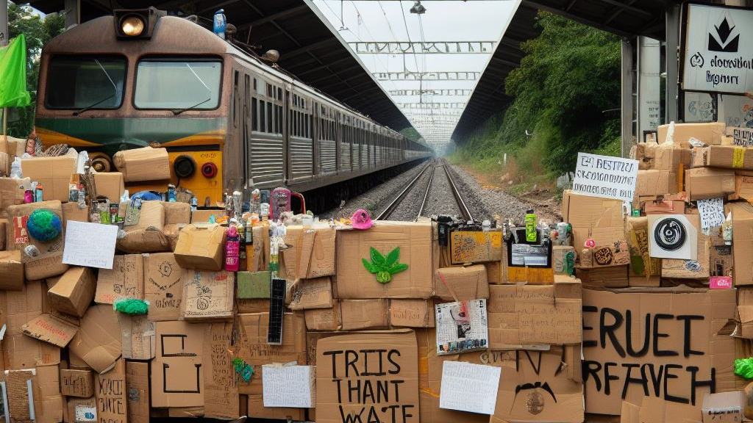
Cautionary Voices

Slide 11
“Mitigating the risk of extinction from AI should be a global priority alongside other societal-scale risks such as pandemics and nuclear war,”
Open Letter Signed by 350 Researchers and Executives Including:
Sam Altman – CEO, OpenAI
Demis Hassabis and James Manyika – Google Senior AI Executives
Kevin Scott – Chief Technology Officer, Microsoft
Eric Horvitz – Chief Science Officer, Microsoft
Existential Risk to Humanity: Alan Turing, Elon Musk, Sam Atman, Bill Gates, Stephen Hawking, Geoffrey Hinton

Slide 13
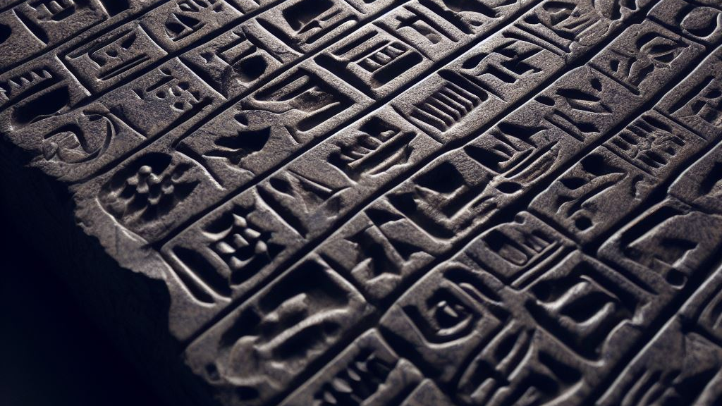
AI Safety
Mechanistic Interpretability
Anthropic
Dario Amodei - CEO

Slide 14
“Social media was the first contact between A.I. and humanity, and humanity lost.” - Yuval Harari, Tristan Harris and Aza Raskin

Slide 15
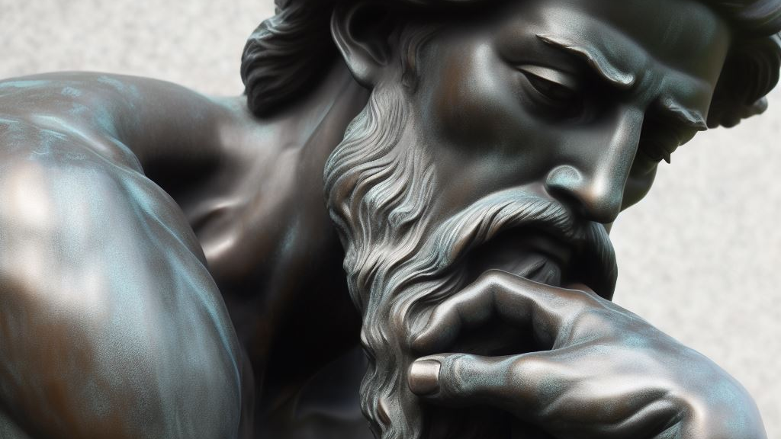
Philosophical Tangent
Tech and Media inventions have been mimicking human function for a century and a half.
Microphones mimic human ears. Cameras mimic human eyes. Computers mimic the human brain. Now we are moving into an era where technology is mimicking the most precious of human functions - Creativity, Craft, and Relationships.
The implications are both staggering and frightening.

Slide 16
AI Media Workflows

Slide 17
Dubbing

Slide 19
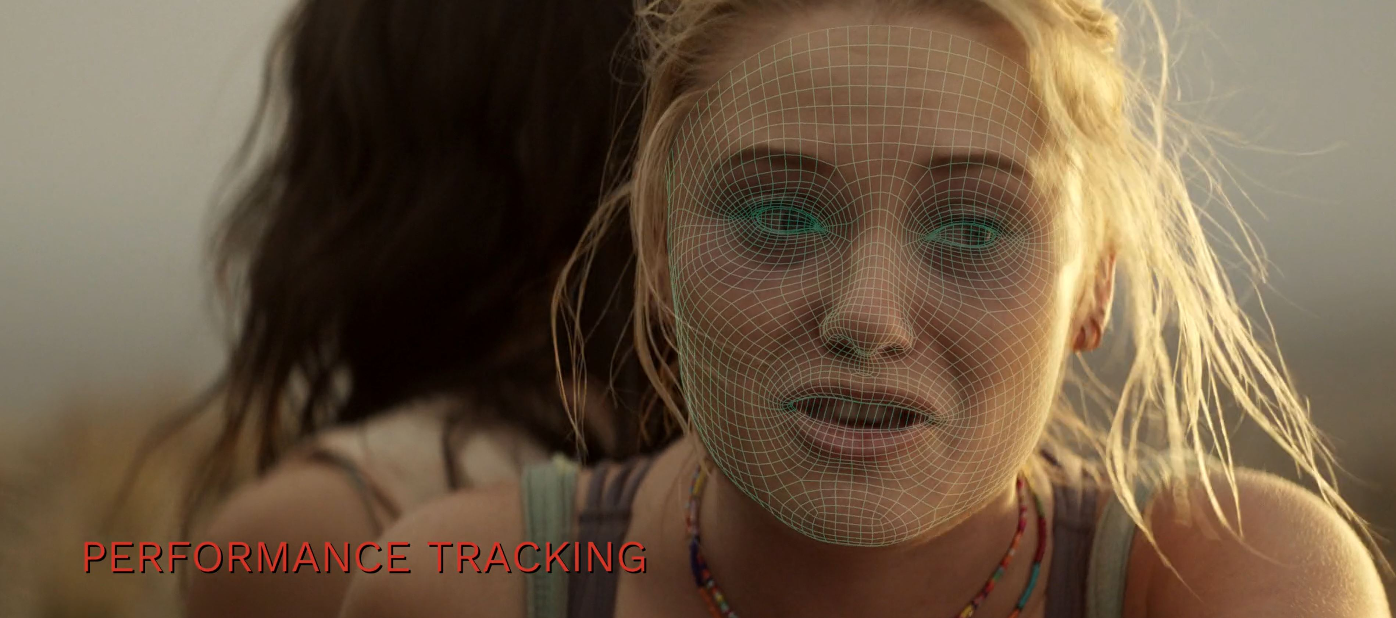

Slide 20
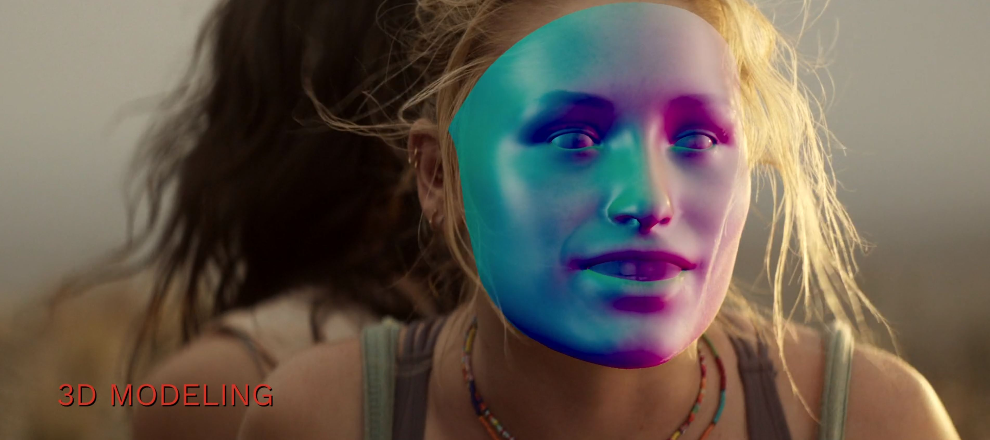

Slide 21
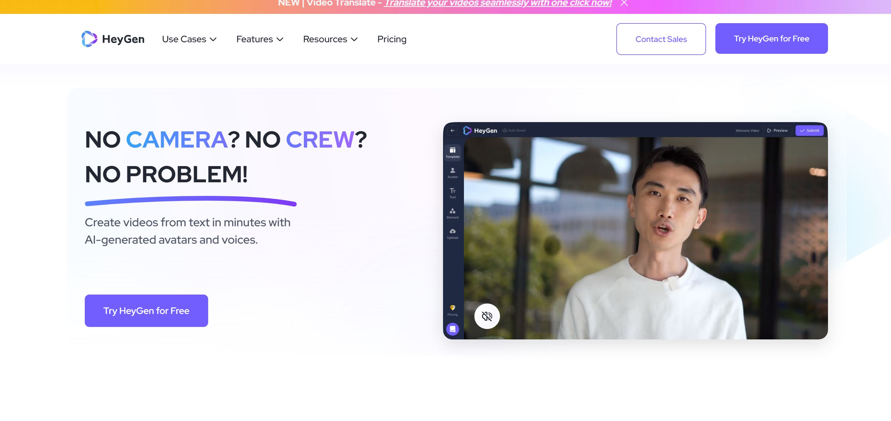

Slide 22
Dubbing
English Master
International Versions
Translaters, Writers, Lawyers, Voice-Over Artists, Mixers, Editors, Technical Staff, Coordinators, Producers…

Slide 23
Dubbing
AI
English Master
International Versions
Generative AI, Voice Cloning, Image Manipulation for Perfect Lip Sync, Language Translation, Large Language Models

Slide 24
Live Production
Real-Time Media Distribution
Sports Event
Director, Technical Director, Camera Operators, Graphics Artists, Audio Mixers, Commentators, Statisticians, Coordinators…

Slide 25
Live Production
AI
Real-Time Media Distribution
Sports Event
Sport-Aware AI Camera Tracking, AI Voice Generation for Commentators, AI Generated Graphics, AI Switching…

Slide 26
Playout and Distribution
TV Station or NOC
Cable and Satellite TV Distribution
Content Prep, Transcoding, Audio Normalization, Editing, SCTE Insertion, Scheduling, Master Control Operators, Sales, Billing, Legal, Content Acquisition, Technical Staff…

Slide 27
Playout and Distribution
AI
CDN and DRM – Streaming Distribution
AI Content Prep and SCTE Insertion, AI Powered VOD, AI Powered Cloud Playout, AI Powered DAI, AI Scheduling…

Slide 28
Media Asset Management
– Tagging, Transcription, Indexing

Slide 29
Media Asset Management
– Tagging, Transcription, Indexing
AI
Emotion Based Indexing, Multilanguage Transcription, Facial Recognition, Image Recognition

Slide 31
Content Creation
Writers, Editors, Actors, 3D Animators, Composers, Visual Effects Artists, Colourists, Audio Mixers…

Slide 32
Content Creation
Fake Drake as a Music Content Creation Example
AI
AI Ability to Learn Content Libraries and Produce New Content, Generative AI

Slide 33
Editing

Slide 35
Prediction With Some Consensus
90% of Editing Jobs Will Be Replaced by AI Within 5 Years

Slide 36
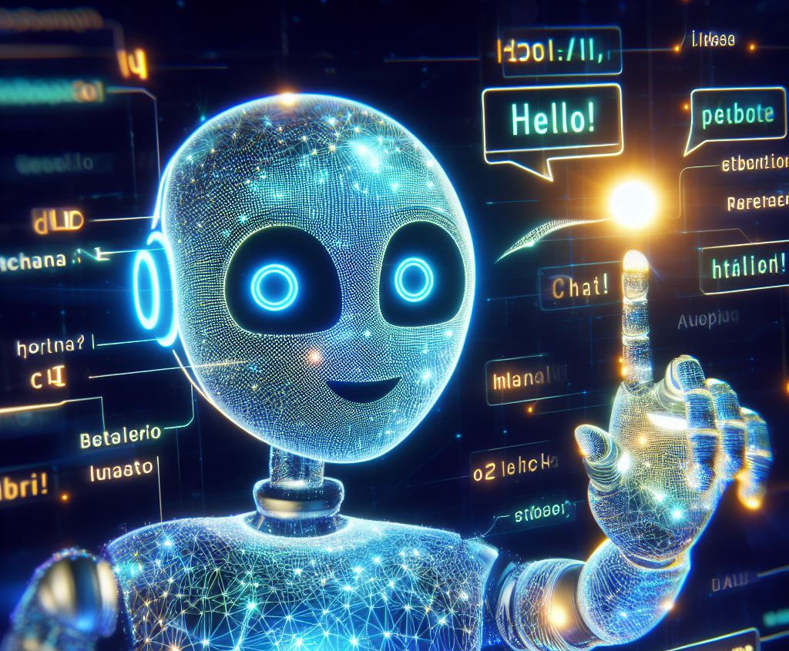
AI Assistant
The AI Gateway
Becoming Prevalent in Media Software
In-Context Design Suggestions
RLHF – Reinforcement Learning from Human Feedback
Creative tools will have access to a vast data set of the creation process of all their users. This will empower the design suggestion engine.

Slide 37
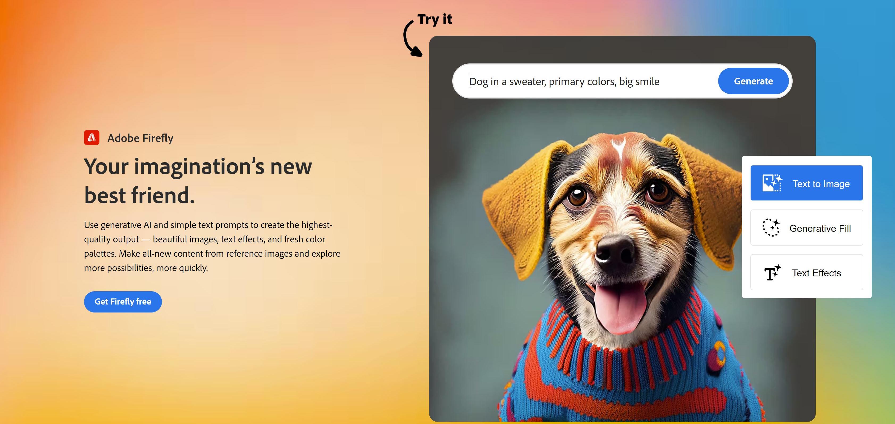
Inside Adobe Apps – Photoshop, Illustrator, Adobe Express

Slide 38
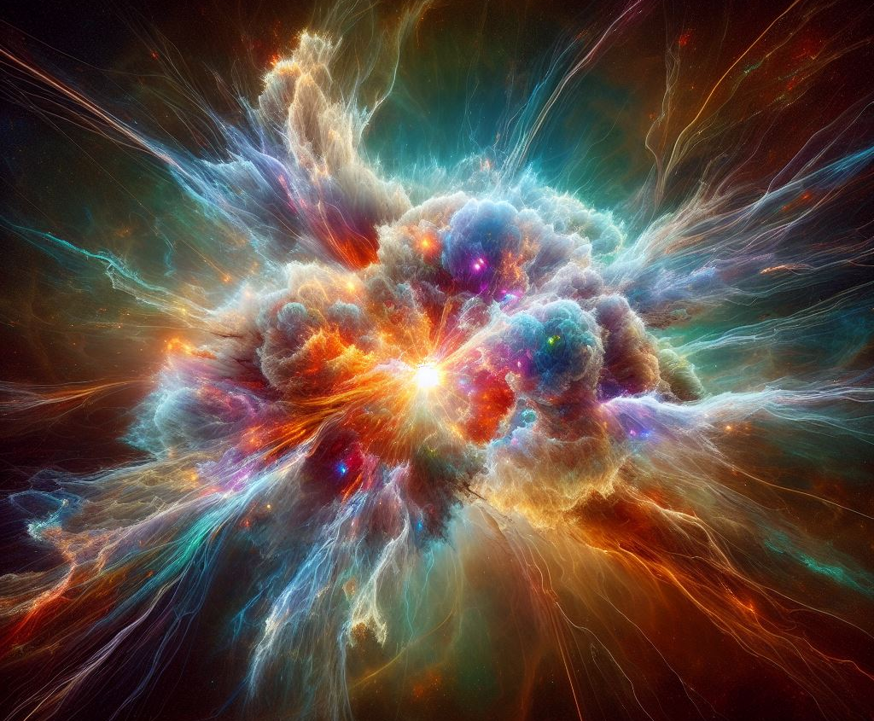
AGI
Artificial General Intelligence
Self-Initiated and Self-Fulfilled Intelligence
Consumes All Existing Knowledge and Refines Its Own Designs

Slide 39
AI is Good at Writing Because it has Consumed and Learned From Virtually Every Word Ever Written. Some Day Not Too Far Away, AI Will Have Learned From Virtually Every Pixel Ever Produced.

Slide 40
Produced by
AI
Directed by
AI
Cast
AI
Written by
AI
Music Composed by
AI
Visual Effects by
AI

Slide 41
Everyone takes the limits of their own vision for the limits of the world.
- Arthur Schopenhauer

Slide 42
Media Technology Implementation Continuum
AI
Stylus, Typewriter
Creation Assist
Text
Printing Press
Replication
Telegraph
Distribution
2022
Autonomous Creation
AI
Microphone, Mixing
Creation Assist
Audio
Foil Recording
Replication
Radio
Distribution
2023
AI
Autonomous Creation
Camera - Silver Chloride
Creation Assist
Still Images
Film Printing
Replication
Digital Prints - Internet
Distribution
2023
Autonomous Creation
AI
Camera - Iconoscope
Creation Assist
Moving Images
Video/Film
Videotape
Replication
TV
Distribution
2023
AI
Autonomous Creation

Slide 43
Positive Story for Broadcasters - News
Media Content That Builds Community and Connection Will Be Highly Valued. It Can’t Be Replaced by AI.
Trusted, Unbiased, Informative Content Will Thrive in Contrast to Deep Fakes and Content That Has an Agenda

Slide 44
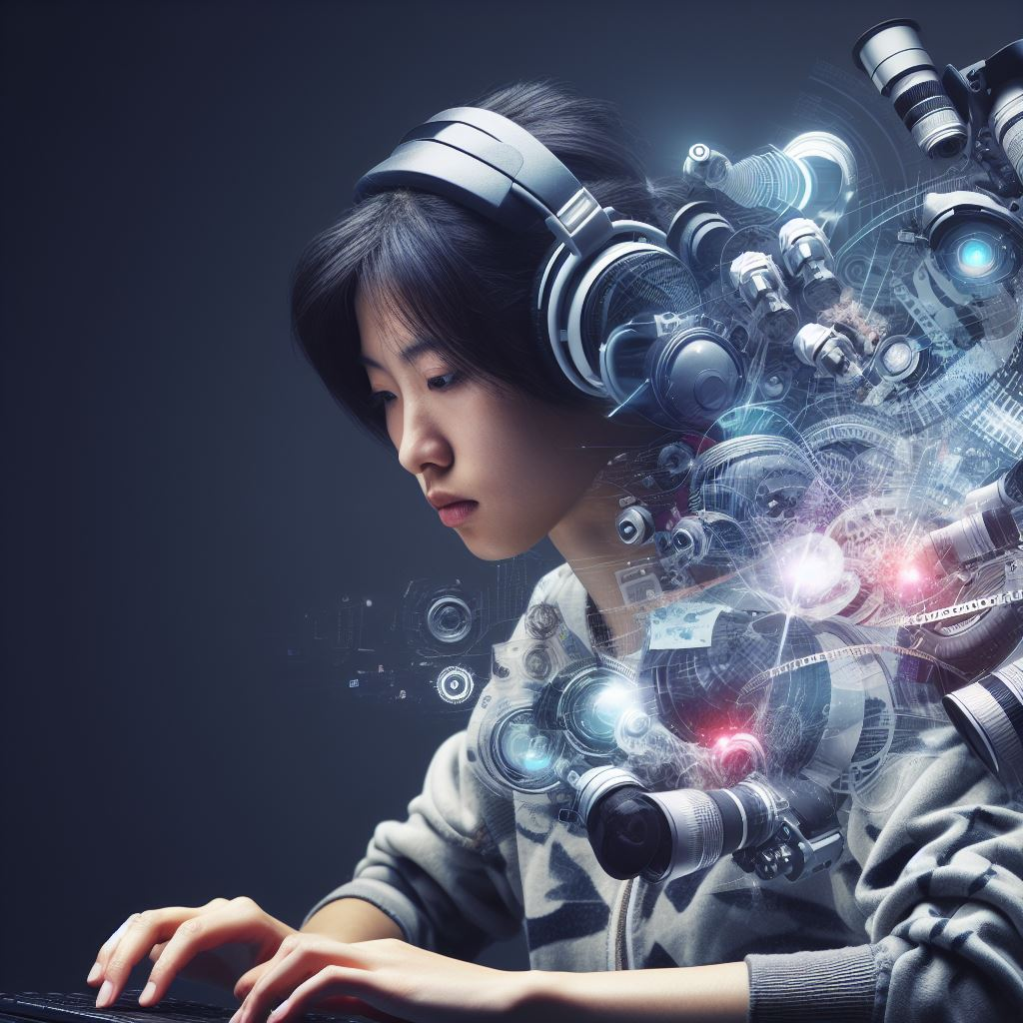
Positive Story for Content Creation Artists
Opportunity For a Single Artist to Execute Their Vision to Create Content
Lowered Barrier of Entry
Explosion of Creative Tools

Slide 45
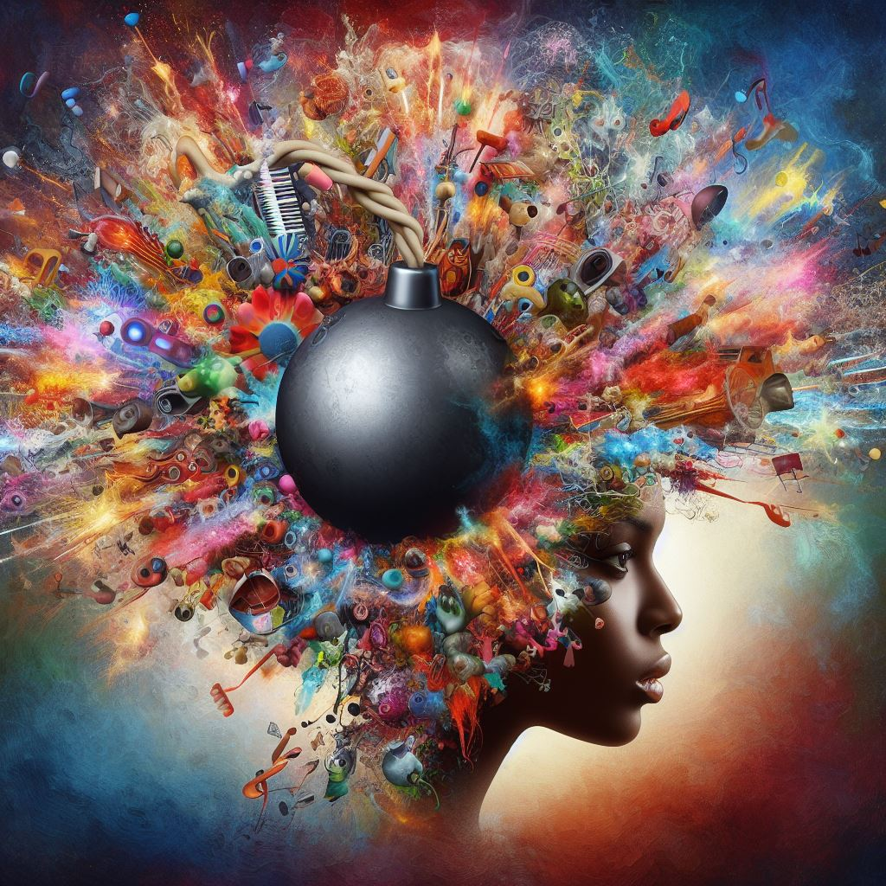
Could AI Catalyze An Era of Explosive Creativity?

Slide 46
Could Media Fully Realize its Promise of Becoming a More Engaging Way to Communicate. Will This Open Up Opportunities for People With Our Skills?

Slide 47
Could it Up Our Game in the Realm of Human Relationships, Community, Empathy, Kindness…?

Slide 48
Could it Result in Heightened Appreciation of Human Craft and Human Connection?

Slide 49
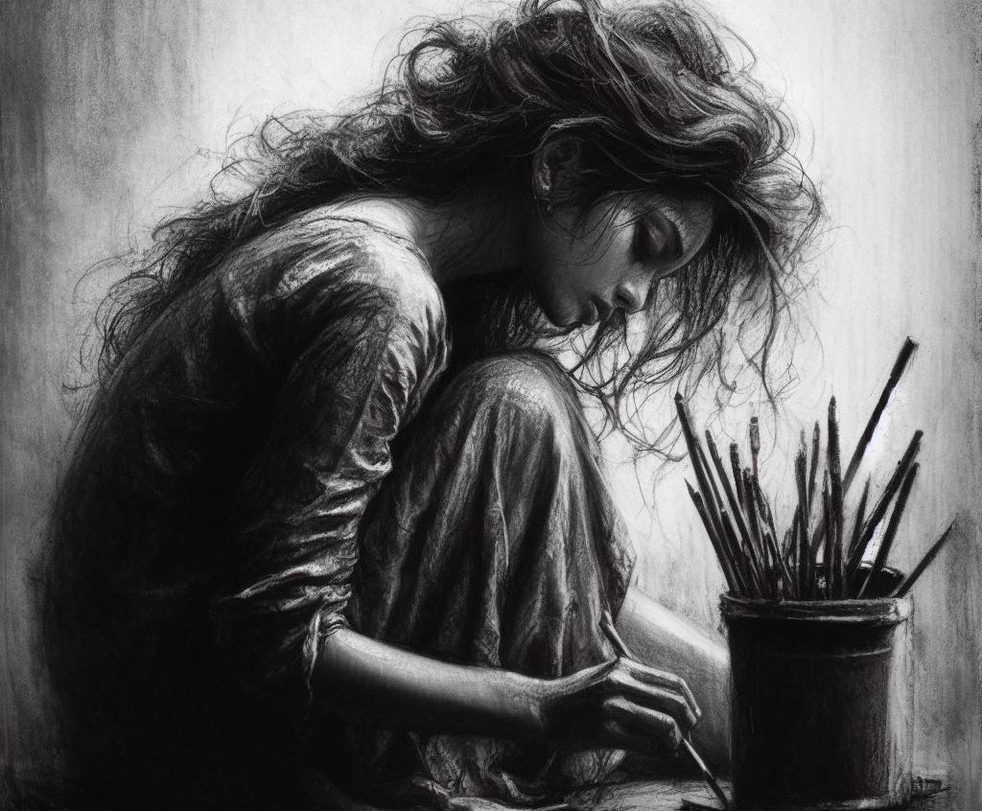
An artist learns a craft, respectfully studies past artists, and lives a life. They are shaped by human relationships and struggle. Genuine ideas are filtered through their experience and new art is produced. I do not want to see this precious human endeavor handed over to machines. I want to consume art that has been created by a human.

Slide 50
Societal Anxiety Creation
Anxiety Creation in the Media Industry
Automation
Social Media
AI
Master Control Operators, Editors, Graphics Artists, Music Composers, 3D Animators…
Auto Workers, Farmers, Teenagers, Writers…
Destabilization of Financial Security, Loss of Control,
Disconnection from People, Destabilization of Reality

Slide 51
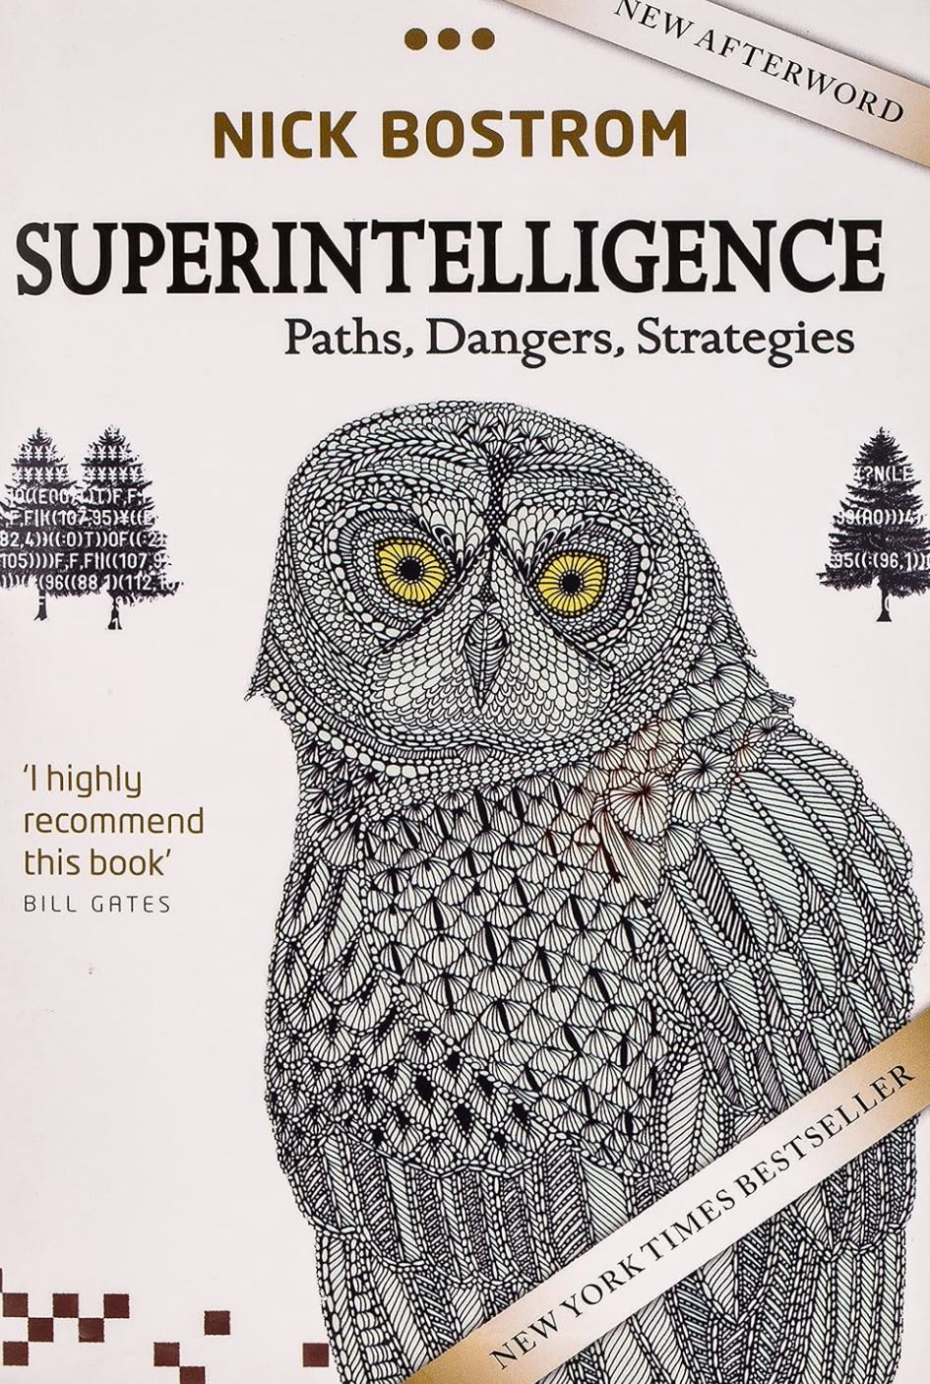
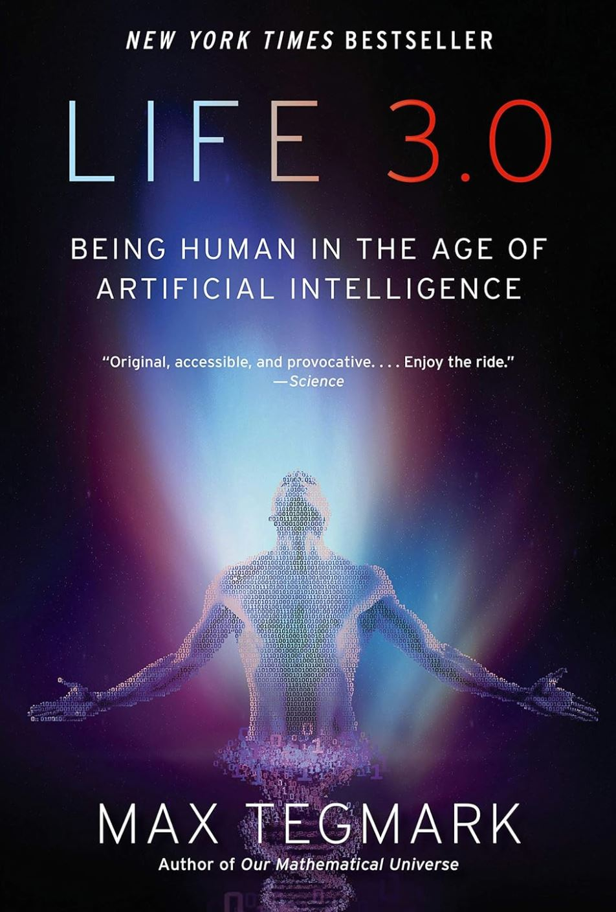
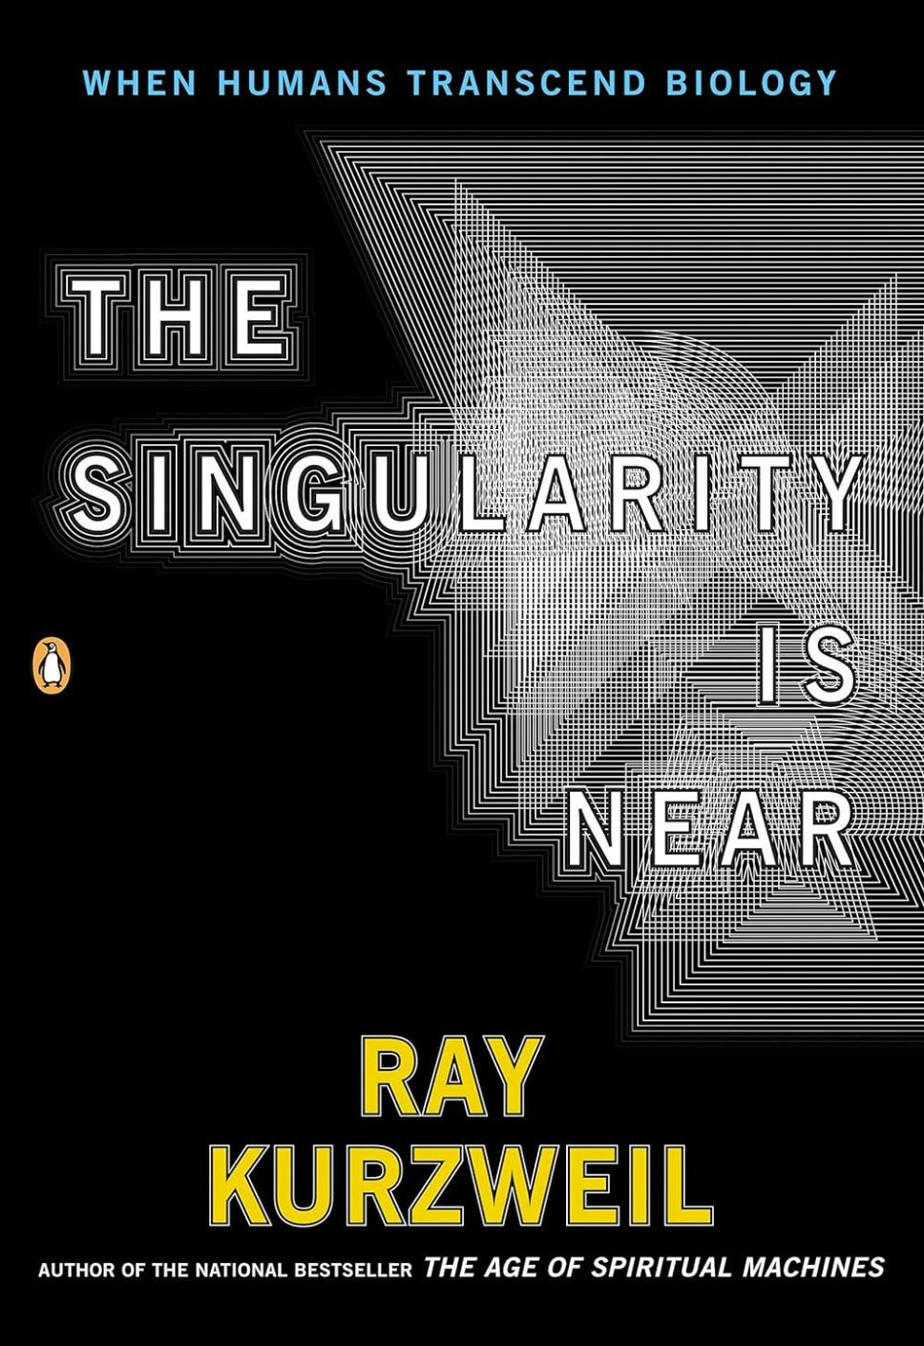
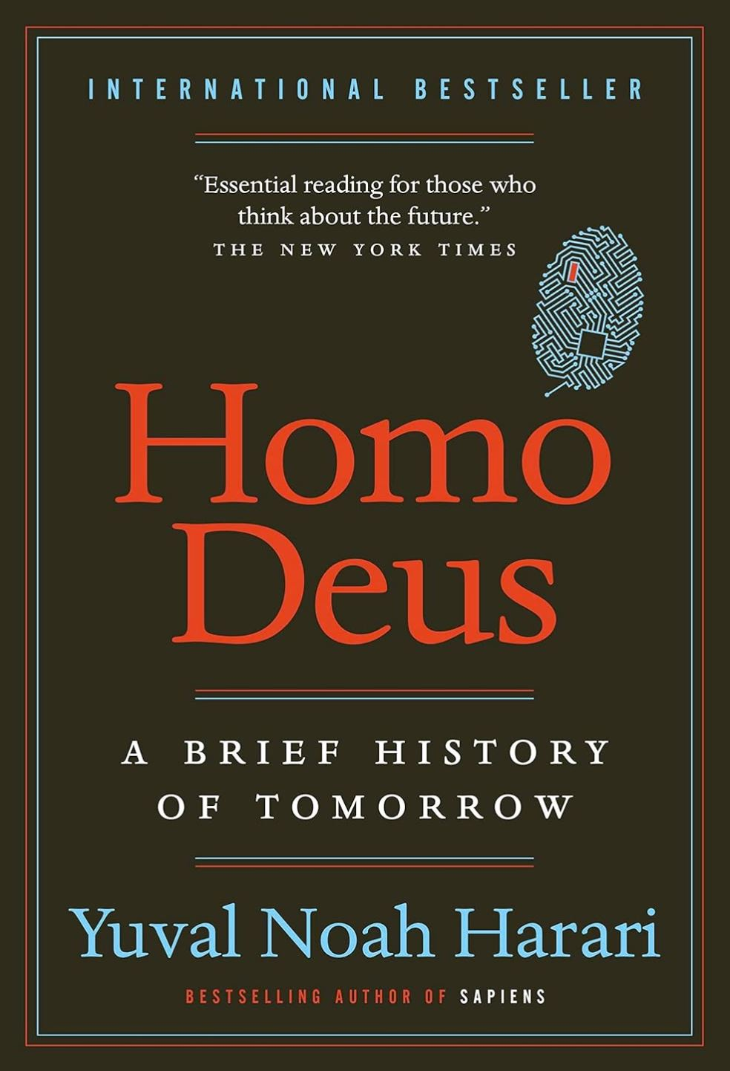
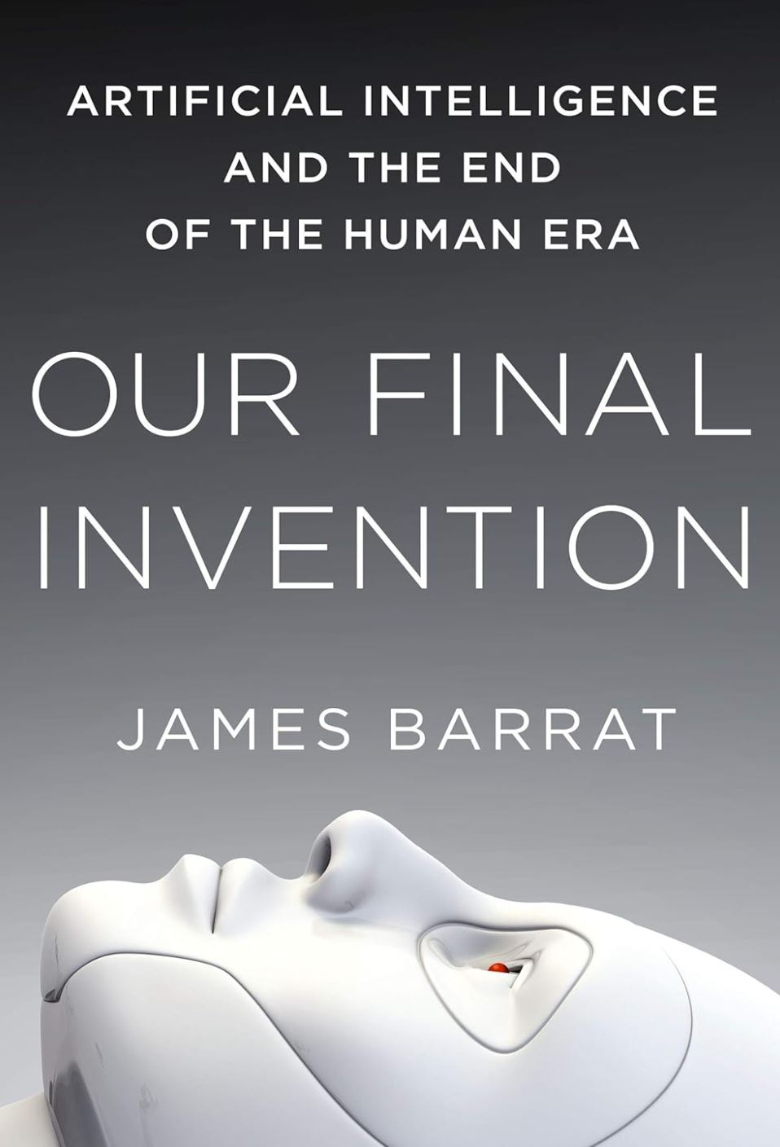
Recommended Reading
To Be Released in 2024: The Singularity is Nearer

Slide 52
AI Tools and Resources for Media – A Sampling
Runway
Midjourney
Dall-E-2 - OpenAI
Flawless AI
HeyJen
Adobe Firefly
Twelve Labs
ChatGPT - OpenAI
Claude - Anthropic
Bard - Google
Stability AI
Magnifi
The AI Dilemma – YouTube
Flip AI
Andrew Ng – Prompt Engineering
Hard Fork Podcast

Slide 53
The New Computer Programming Language is English
Learn the AI Tools – The Ability to Integrate AI Tools Into Media Workflows Is a High-Value Skill
Become a Prompt Engineer
Andrew Ng - Resource

Slide 54
How Will AI Change the Media Industry?
People
Jobs
Productivity
Valued Skills
Opportunity for People Who Know AI Tools and Media Workflows
Increased Appreciation for Human Craft
Heightened Desire for Content That Connects us to the Artist and to Our Communities?
Business
Monetization
Distribution
Opportunities for Trusted Providers of News and Educational Content That Connects People
Opportunities to Build Communities

Slide 55
Conclusion
AI Will Bring On Unprecedented Change in the Media Industry.
AI Will Cause the Greatest Societal Change in Human History.

Slide 56
Ideas are Priceless Human Things.
Creativity is Priceless.
Human Craft is Priceless.
Truth is Priceless.
Human Relationships are Priceless.
Serving Humans is Priceless.
Sense of Accomplishment is Priceless.
Pride in Human Work is Priceless.
Free Will is Priceless.

Slide 57
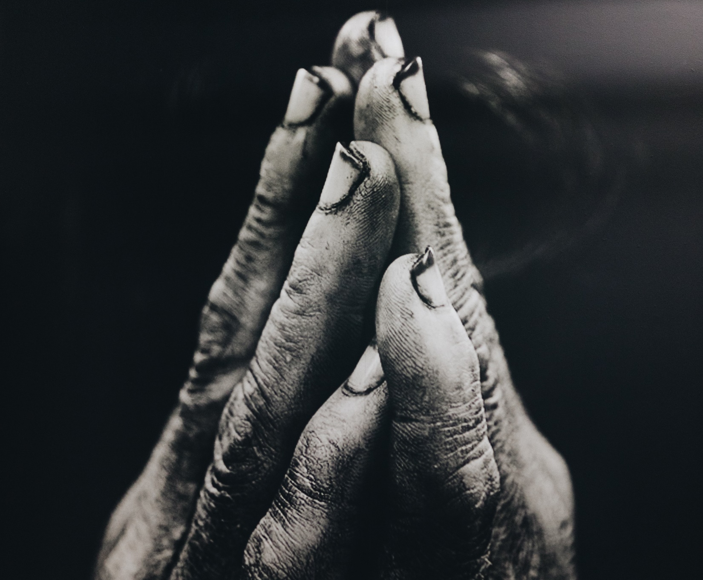
Thank You
Roy Folkman
(Human Presenter)
CineSys.io
roy.folkman@cinesys.io
519-835-8828

Slide 58
Gerry and Chris

Slide 59
Your Comments and Questions

Slide 60
AI Concern Spectrum
AI Represents an Existential Threat to Humanity.
AI Represents a Significant Technological Change but We Will Adapt. We Always Have.
AI is the Most Consequential and Dangerous Force of Change in Society.
AI is Going to Kill Us All.
AI is a Nothing Burger.
0
1
2
3
4
5
6
7
8
9
10

Slide 61
It’s About The Data Set
Twitter (Now X):
Opinions, Preferences, Information
Tesla:
Real World Environmental Data
Google:
Search Intent
YouTube Behavior
Gmail
Amazon:
Purchasing Behavior
Meta (Facebook):
Real People Preference and Behavioral Data

Slide 62
Applications of AI in Our Industry – Jobs Affected
Camera Operators
Editing
Graphics Design
Graphics Generation
Writing
News (Personalized)
Music Composition
Dynamic Ad Insertion
Metadata Creation
Speech to Text – Captioning
Dubbing
Content Management
Dialogue Replacement
Colourists
Sports Commentary
Engineers
Traffic/Scheduling
Content Preparation
Audio Mixing
Voice Over Artists
News Presenters

Slide 63
Discussion Points
What happens if AI companies start outcompeting companies that use humans?
AI will start doing the AI research. Testing it’s code and rewriting.
RLHF – AI will be capable of providing its own feedback
It’s difficult for us to comprehend all the implications. The limits of our world are changing.

Slide 64
Thank You
Roy Folkman
(Human Presenter)
CineSys.io
roy.folkman@cinesys.io
519-835-8828

Slide 65
Glossary
Generative AI
Large Language Models
Neural Networks
Mechanistic Interpretability
Prompt Engineer
Singularity
Effective Altruism
Transformer. The T in GPT. Everything is language.
Multi-Modal
AI Alignment

Slide 66
The Positive Story
3 Day work week
Make us better humans
Explosion of Creativity and content
Lowered barrier of entry for media content creation and distribution
Health Care and Medical Science
Make us value human craft and human creativity more

