Slide 1


Adventures in Broadcasting with The City of Calgary: Datacasting for Municipalities
Erin Ruttan
Program Designer - Digital Equity and ATSC 3.0, City of Calgary
WABE Conference - November 2023

Slide 2

Smart Cities
Smart Cities
Achieve meaningful outcomes for residents using data and connected technology. However, it isn’t just how The City of Calgary delivers services or solves community problems, it’s also how we enable businesses, entrepreneurs ​and communities to create solutions. ​
- Jan Bradley, Chief Information Technology Officer, The City of Calgary​

Slide 3
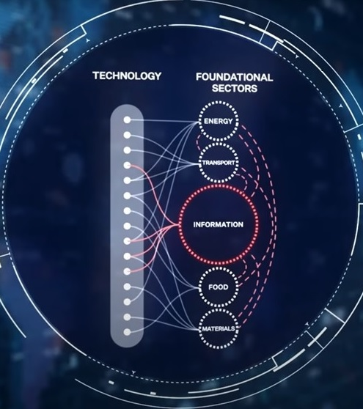

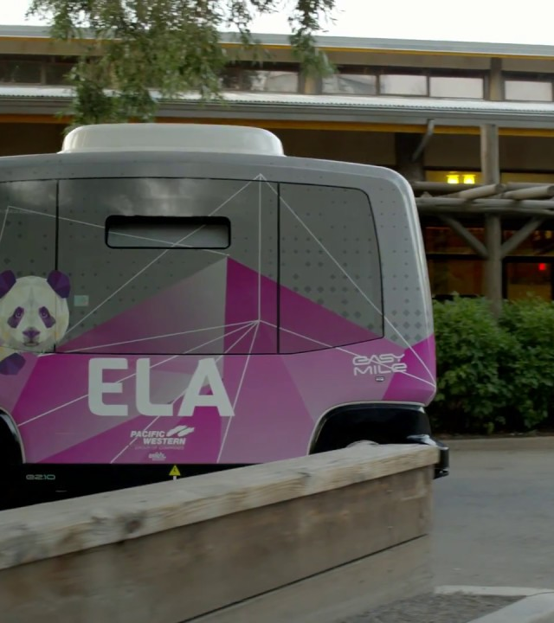
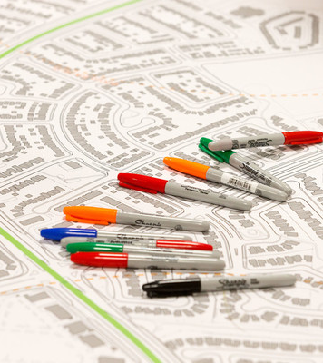

Smart Calgary Pillars
Technology Integration Center
TIC
Digital Equity Program
DE
Living Labs Program
LL
Telling our Story
MPR

Slide 4




Digital Equity
& ATSC 3.0
Makes lives better every day by reducing barriers that contribute to the digital divide and help Calgarians connect online the way they want to
Getting information to people and places that are hard to reach
Affordability
Accessibility
Literacy
Sustainment
More than ½ have the wrong device
Almost ½ without home internet
Almost ½ lack the literacy skills
More than ¾ experience 1+ barrier

Slide 5
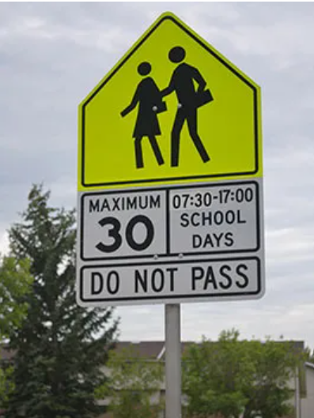
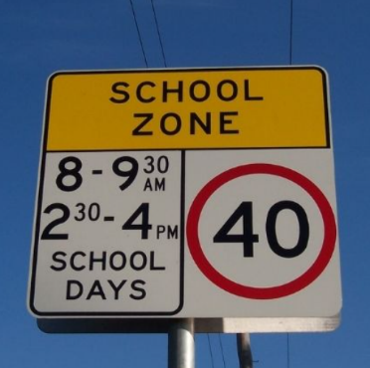
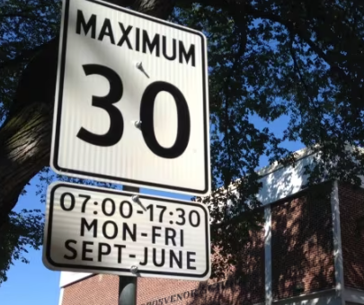
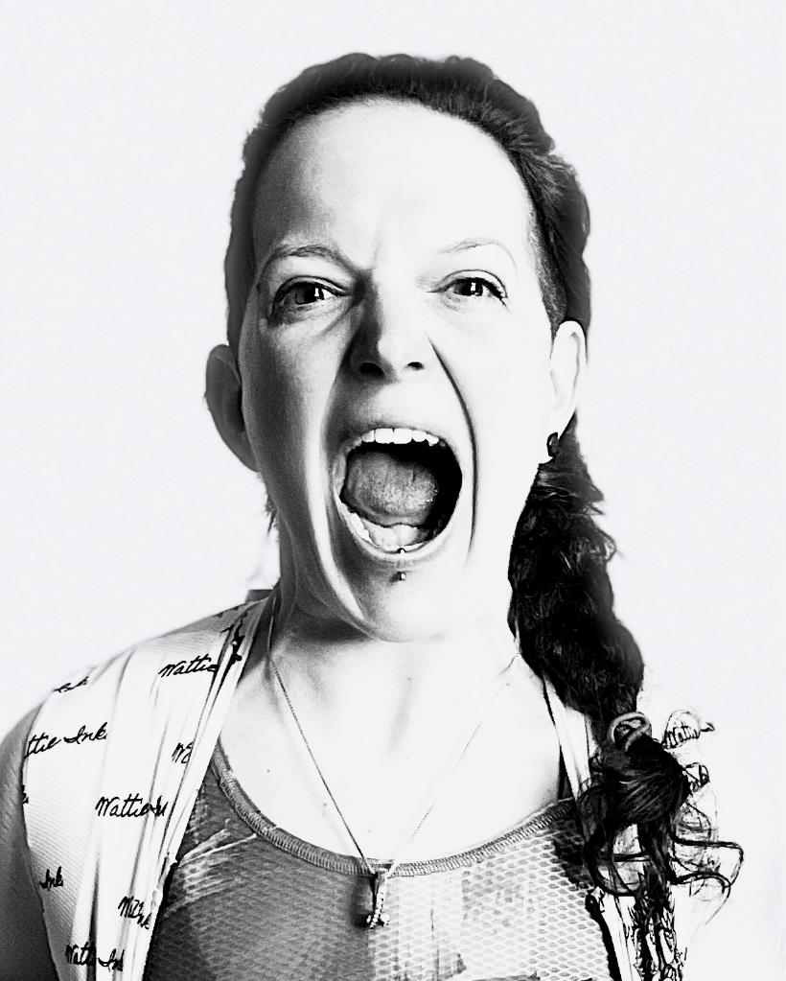
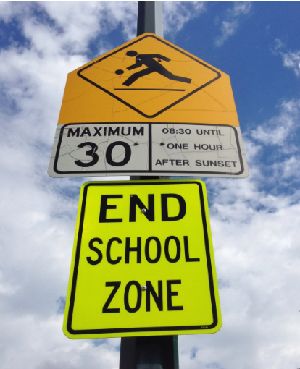

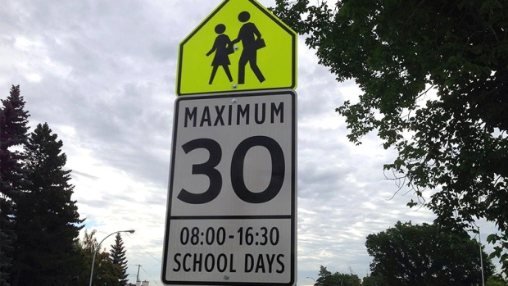
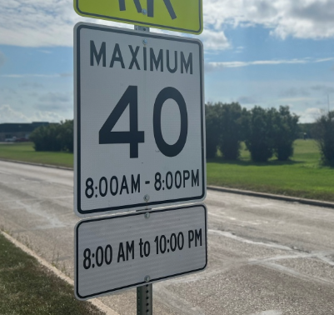
give me a sign

Slide 6

give me a sign
one sign

Slide 7

Picture this …...
Collision 10km ahead.
Take next exit to avoid delay

Slide 8
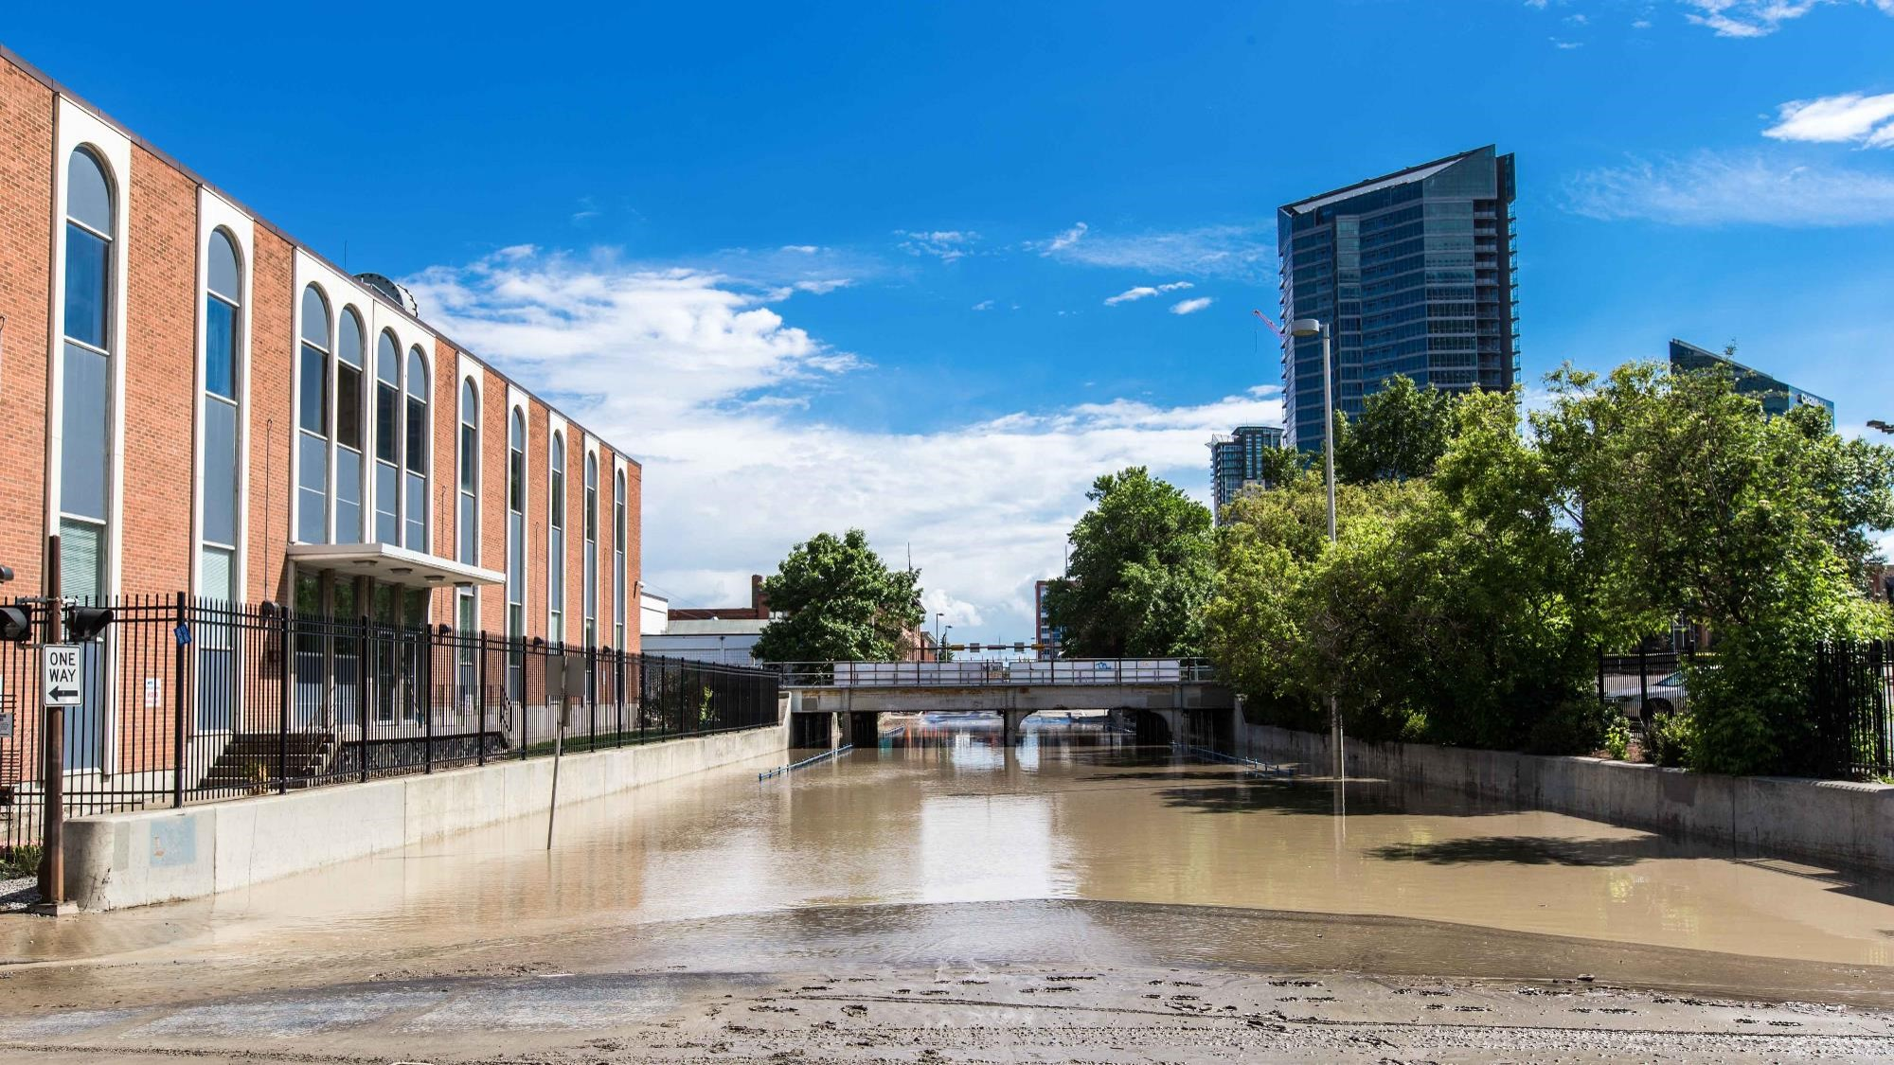
Benefits
Benefits
Device agnostic
Location specific
Accurate messaging
Flexible
Redundant

Slide 9
Why this why now
Shifting how we send information can:
Leverage existing infrastructure and underutilized spectrum
Help us be better prepared for large scale emergencies
Allow us to better support our community
Save time and money
Reduce emissions

Slide 10
Technical
527 MHz
  Allows for SFN transmitters
10kW ERP
  Allows us to reach neighboring communities with low connectivity
Phase one single tower implementation

Slide 11
Expected range
Blue = noise limit
Brown = urban contour

Slide 12
Next Steps
License application to ISED
Legal agreements in place
Receive license
Begin experimentation
Make a case for regulatory change to allow for multicasting

Slide 13

Thank you
Erin.Ruttan@calgary.ca

